Slide 1
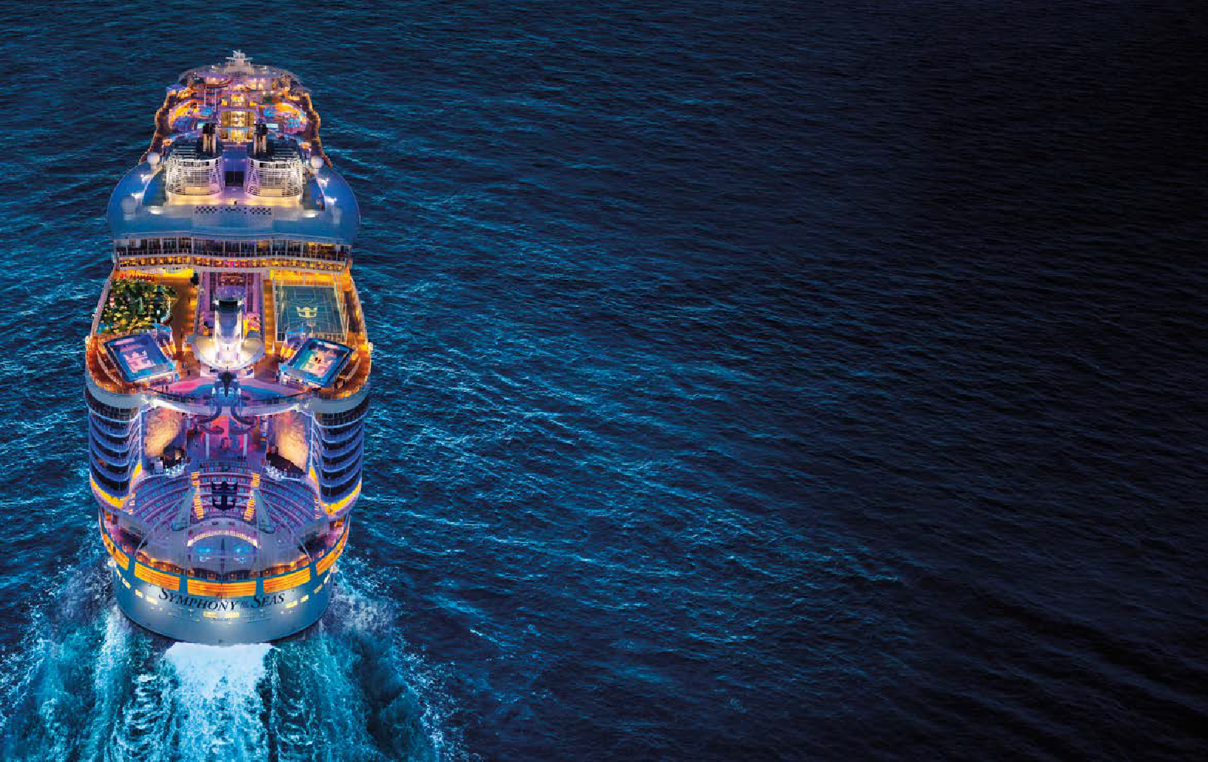

B R A N D G U I D E L I N E S v 1 . 2
Symphony of the Seas® | Asset ID 42162
TRADE P AR TNER VER SION

Slide 2

I N D E X
R O Y AL C ARIBBEAN ®
COME SEEK BRAND GUIDELINES
Section No. 3
C A M P A I G N
CORPOR ATE GUIDELINES 43
Brand Name 44
Trademarks 45
Corporate Logo 46
Crown and Anchor 48
Compass 50
Accolades 52
E L E M E N T S
10
12
13
17
Addressing Travel Partners 18
Section No. 1
B A C K G R O U N D
T ONE GUIDANCE
Headlines Body Copy
Call To Action
MISSION
4
OUR TARGET
5
DESIGN GUIDELINES
Online Digital Library
19
20
21
23
25
27
Section No. 4
Come Seek Lockup
C A M P A I G N D E S I G N
Section No. 2
C O M E S E E K
WH AT IS COME SEEK ?
Color Palette Typography Borders
PRINT
Full Page Ads Colorblock Ads Spread Ads
Partner CTAs Flyers
Posters
54
55
57
59
62
64
65
7
PHO T OGRAPHY
31
C AM PAIGN FI LTER
8
OOH
67

Slide 3
R O Y AL C ARIBBEAN ®
COME SEEK BRAND GUIDELINES
S E C T I O N N o . 1
B A C K G R O U N D

Slide 4
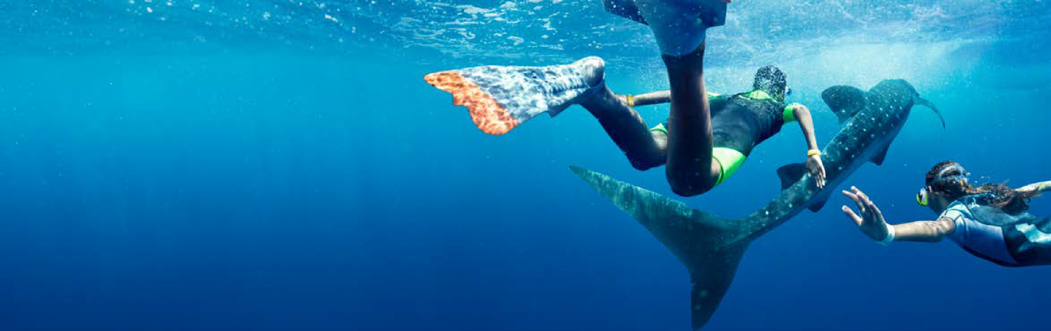

O U R M I S S I O N :
N o . 1
BA CKGR OUND >> MISSION
I N S P I R E A D V E N T U R E
Cozumel, Mexico | Asset ID 38298
WE BELIEVE that life is best lived when filled with as much
adventure as possible. So WE INSPIRE adventures that expand your horizons, bring you to life and connect you to people.

Slide 5
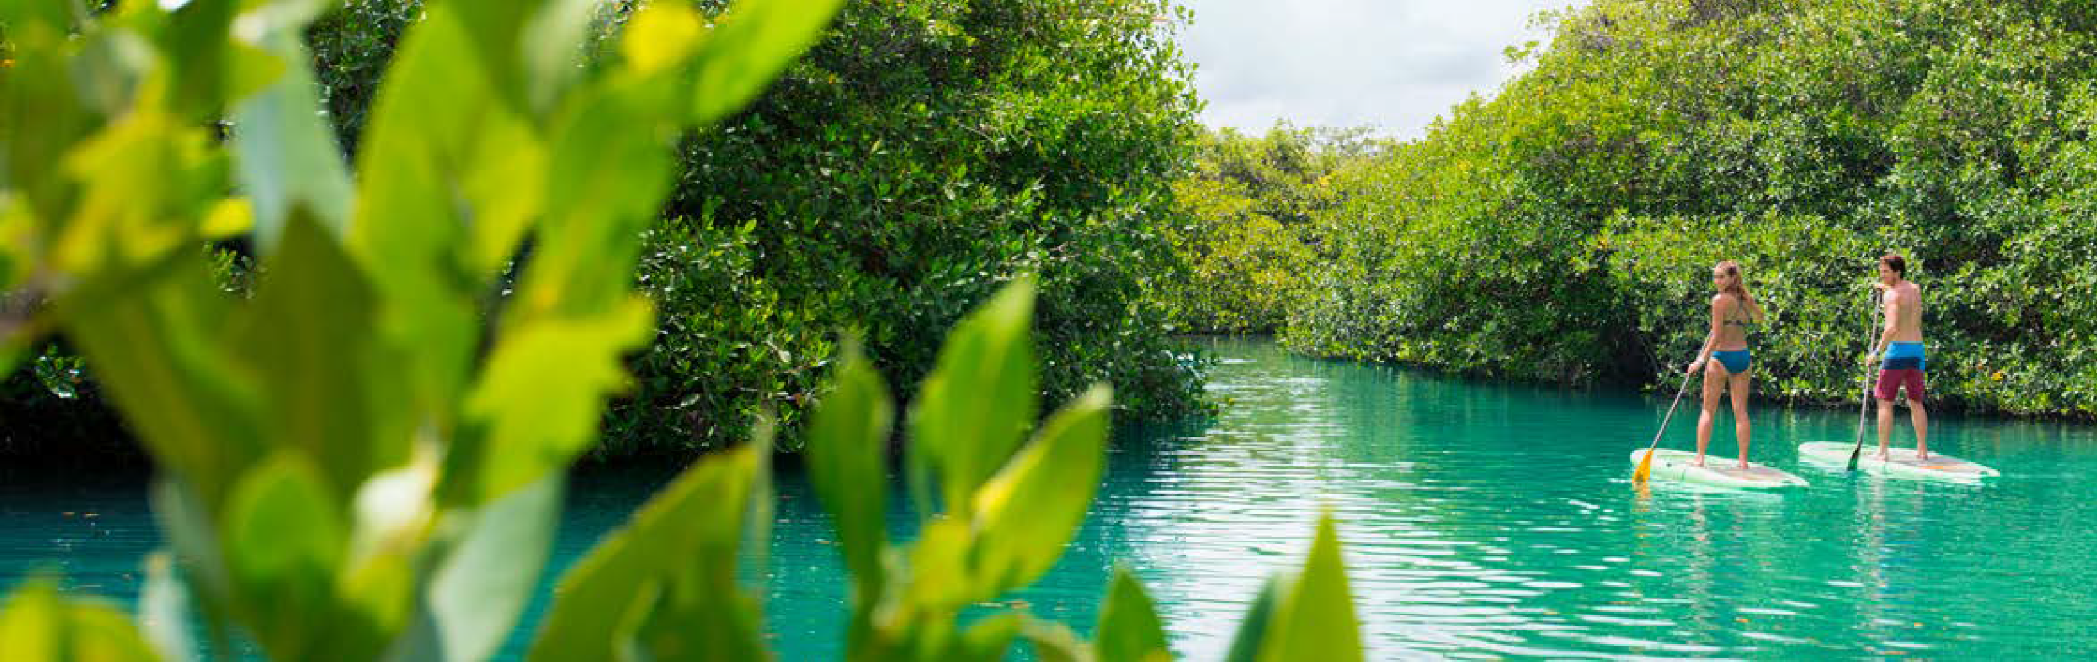



O U R T A R G E T : S E E K E R S
N o . 1
BA CKGR OUND >> OUR TARGET : SEEKER S
Being a seeker isn’t about age, demographic, or affinity for cruising — it’s about attitude. They are culturally curious, new experience-craving explorers who prioritize travel in their lives, finding deep, meaningful value in going new places and seeing new things. They
travel to foreign places to learn about other cultures. They bring the whole family together to bond, grow, and gain new perspectives. They believe the collection of these experiences is a huge part of who they are and the identity they reflect to everyone around them.
Cozumel, Mexico | Asset ID 38282
Travel
Curiosity
Influence
More likely to seek adventure and new experiences when traveling on vacation.
Experiences make up their identity, long after the quick hit of the
humble-brag goes away.
First to try new things, and often influence their friends and family.
Ideal feelings on vacation include excited, relaxed, rejuvenated and inspired.
About 50% have kids, and want to provide their family with
adventurous experiences.
Motivated by new destinations, excellent food, learning about culture and personal growth.

Slide 6
R O Y AL C ARIBBEAN ®
COME SEEK BRAND GUIDELINES
S E C T I O N N o . 2
C O M E S E E K

Slide 7
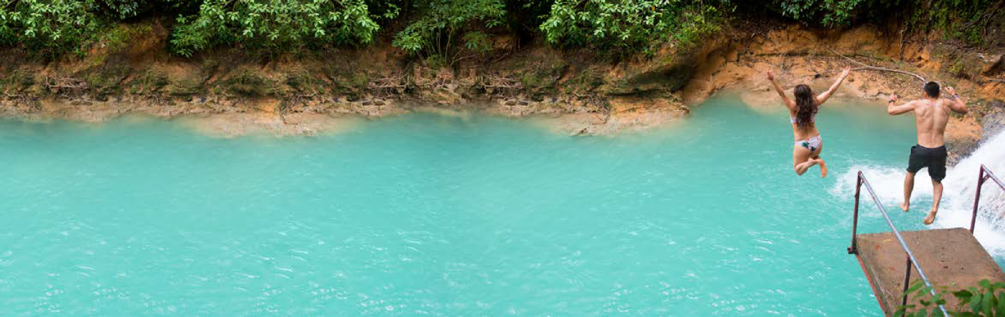
N o . 2
COME SEEK >> WHAT IS COME SEEK ?
Blue Hole — Falmouth, Jamaica | Asset ID 36444
W H A T I S
C O M E S E E K ?
Since launching in 2015, Come Seek has challenged cruising
clichés with a distinct, clearly defined point of view. But this is not a campaign — it’s an invitation to embrace adventure.

Slide 8
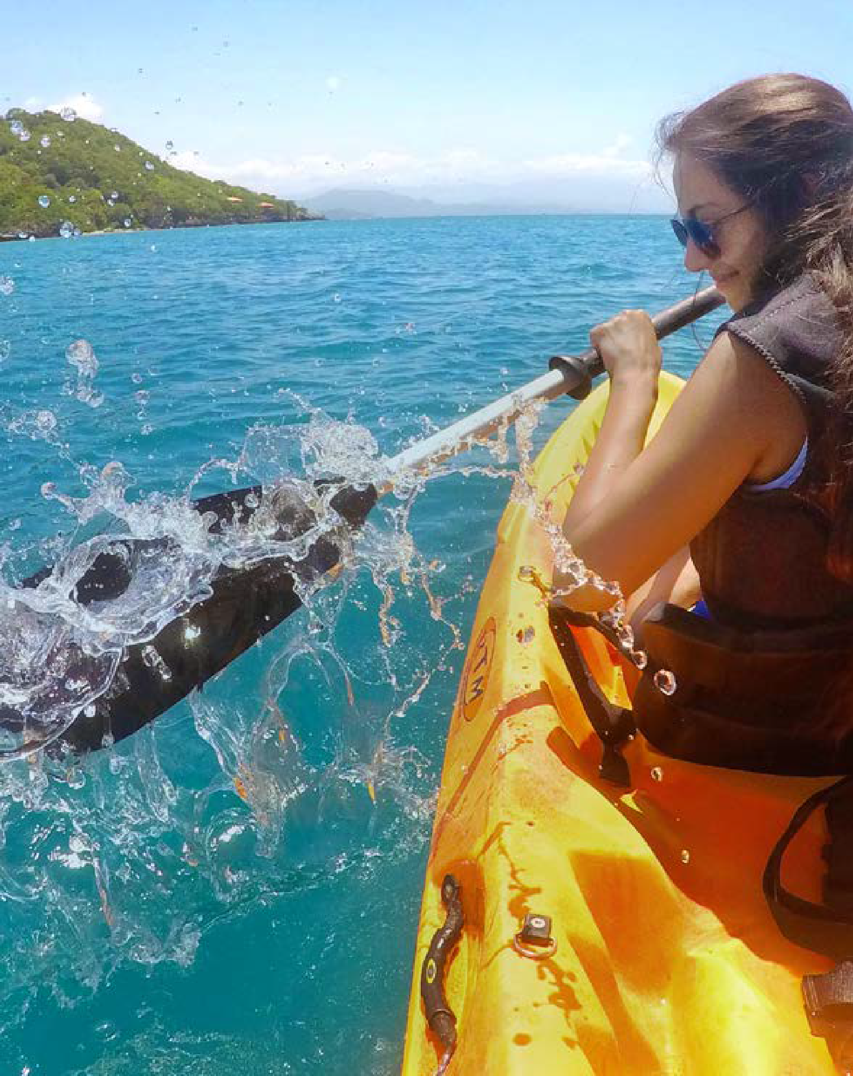
Labadee®, Haiti | Asset ID 38887
N o . 2
COME SEEK >> C AMP AIGN FI LTER S
H O W W E F I L T E R W O R K
Bold adventures deserve bold marketing.
B E R E W A R D I N G
B E I N T E R A C T I V E B E I N T R I G U I N G
B E E Y E - O P E N I N G
Does it showcase adventure?
Showcase new experiences of all sorts — new foods, new cultures and new ways of interacting with nature are all great options.
Is it challenging cruising conventions?
This is not a cruise — to make that claim, we have to back it up by depicting norm-defying experiences.
Does it present the destination in a surprising way?
Come Seek is all about surprising people with unique, unexpected cultural adventures.
Does it portray a journey within an experience?
The ideal creative brings moments to life by conveying powerful emotions, like anticipation, bravery and joy.
Does it speak to a diverse audience?
Focus on featuring a diverse representation, rather than a single target.
Is it portraying authentic moments?
We want to represent real moments with real people — not anything overly polished or staged.

Slide 9
R O Y AL C ARIBBEAN ®
COME SEEK BRAND GUIDELINES
S E C T I O N N o . 3
C A M P A I G N E L E M E N T S

Slide 10
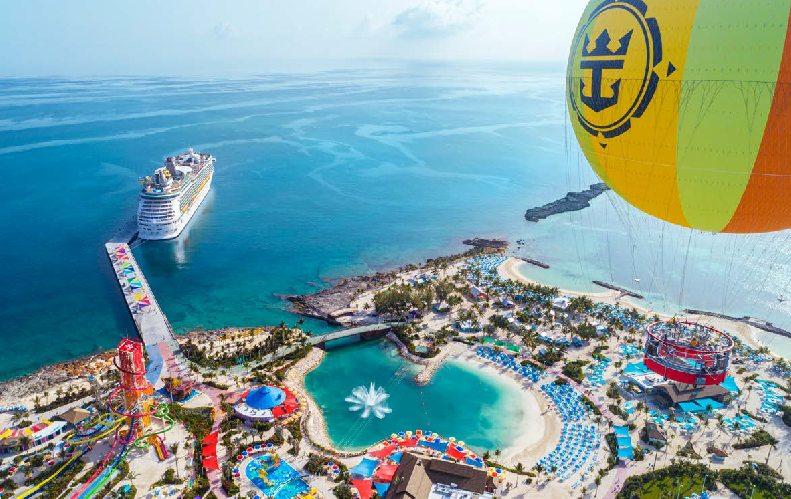
Perfect Day at CocoCay, Bahamas | Asset ID 52143
N o . 3
C AMP AIGN ELEMENTS >> T ONE GUID ANCE
C A M P A I G N E L E M E N T S
T O N E G U I D A N C E

Slide 11
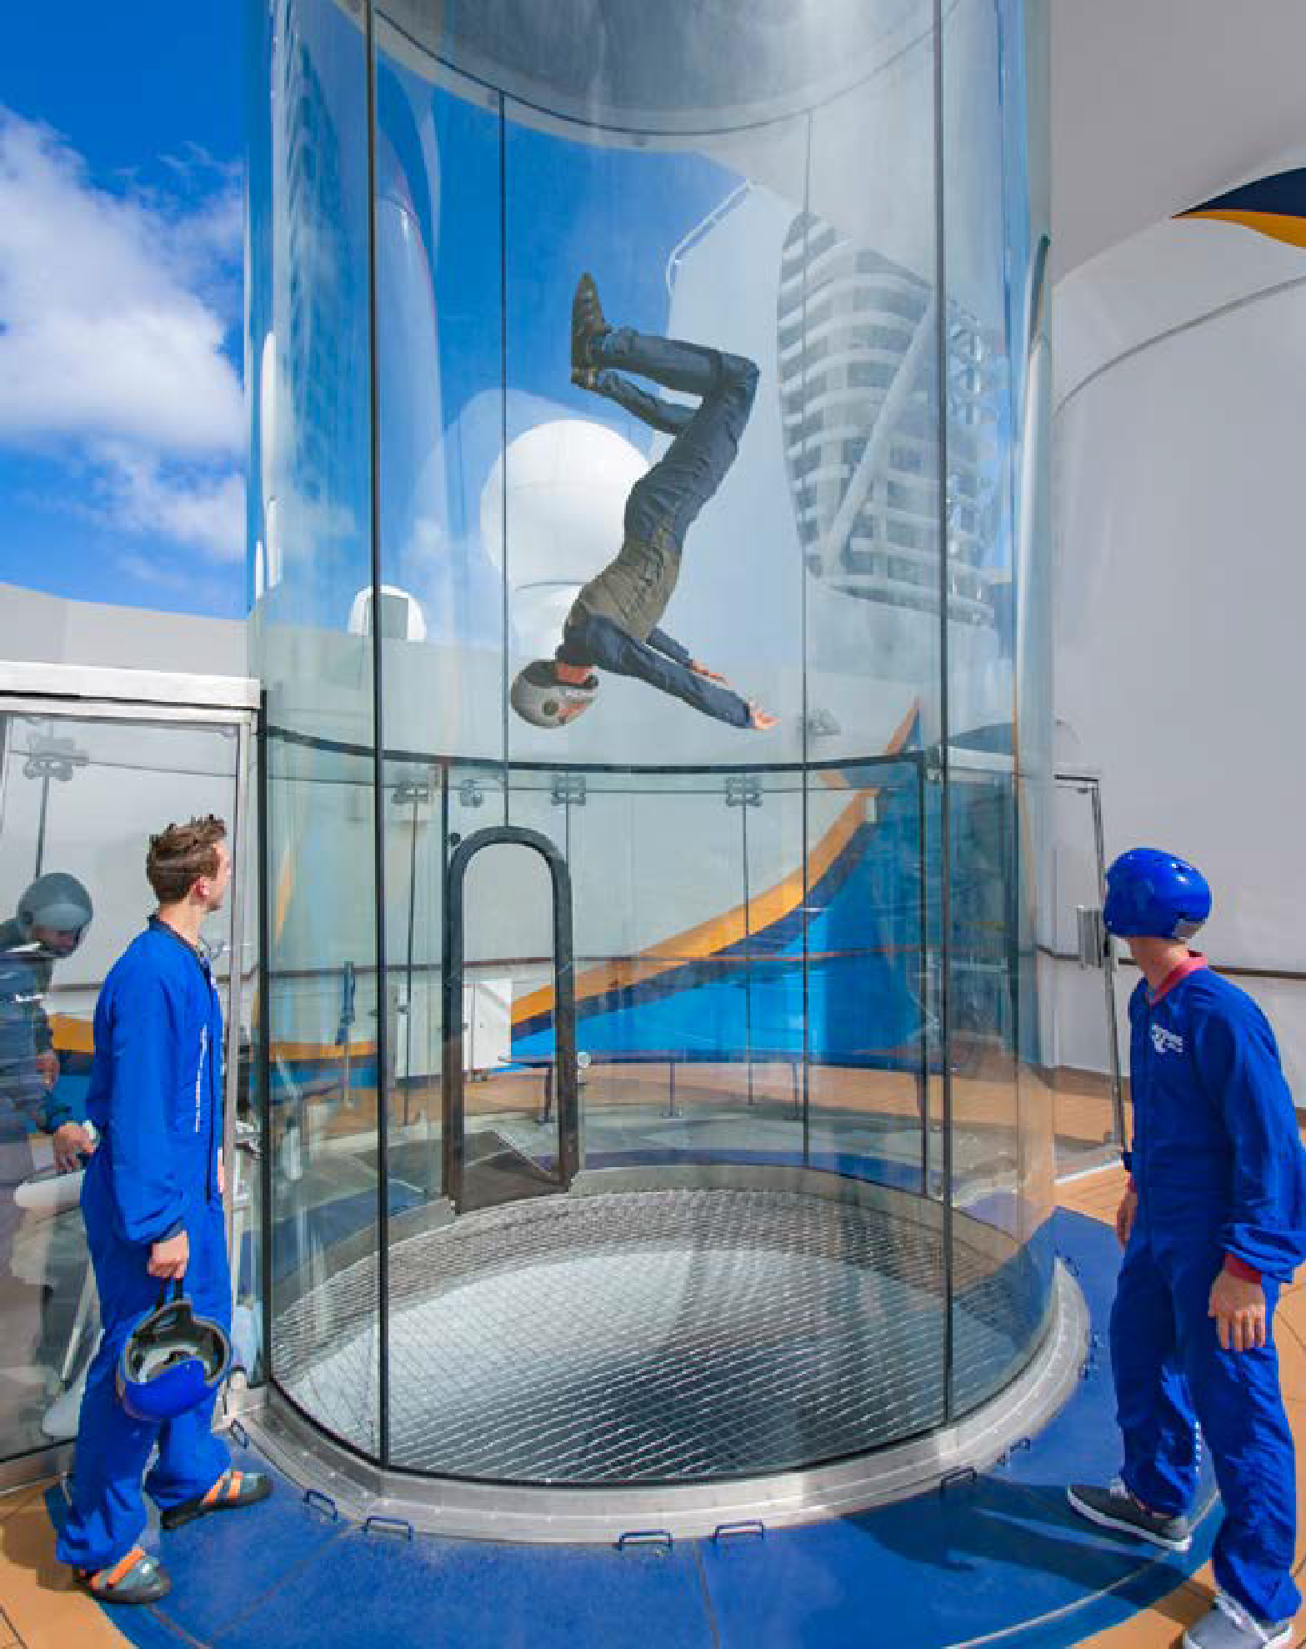
RipCord® by iFLY® | Asset ID 37646
N o . 3
C AMP AIGN ELEMENTS >> T ONE GUID ANCE
T O N E G U I D A N C E
The Come Seek campaign uses distinct language to portray our brand in an exciting and energetic way that evokes emotion. We use descriptive
phrases and vibrant details to engage the reader, while keeping in mind certain distinctions.
WE ARE
Clever
Conversational Friendly
Adventurous Smart
Emotive
WE ARE N OT
Ha-ha Funny
Forced Cool
Overly Familiar
Extreme
Pretentious
Mushy

Slide 12
N o . 3
C AMP AIGN ELEMENTS >> T ONE GUID ANCE >> HEADLINES
HEADLINE EXAMPLES
H E A D L I N E S A N D H O W T H E Y W O R K
Headlines can be playful and fun. They may
challenge convention and inspire the reader. Or they might remix a cliché. But they always say things in a distinct manner.
Classic Campaign Style
T H I S I S N O W A V E
L E F T U N T U R N E D
Imperative / Product-focused
W E E K E N D L I K E
Y O U M E A N I T
Challenger Statement
Y O U A R E Y O U R O W N
S E A R C H E N G I N E
Stop Wondering. Start Wandering.
W H A T I F Y O U P I C K
N O W O V E R N E V E R ?
Don’t sacrifice clarity for the sake of cleverness — the reader needs to understand what you’re saying
Our headlines omit all punctuation, so no hyphens, periods,
commas, colons, etc. — grammar teachers will cringe, but the clean layouts will thank you
The exception is the use of question marks when we write interrogative headlines for our yearly WAVE campaign,
“Stop Wondering. Start Wandering.”
One option is to give an old saying a new spin
Another is to use imperative phrases
Rhyming and alliteration are useful too, as long as the language is bold and paints a picture

Slide 13
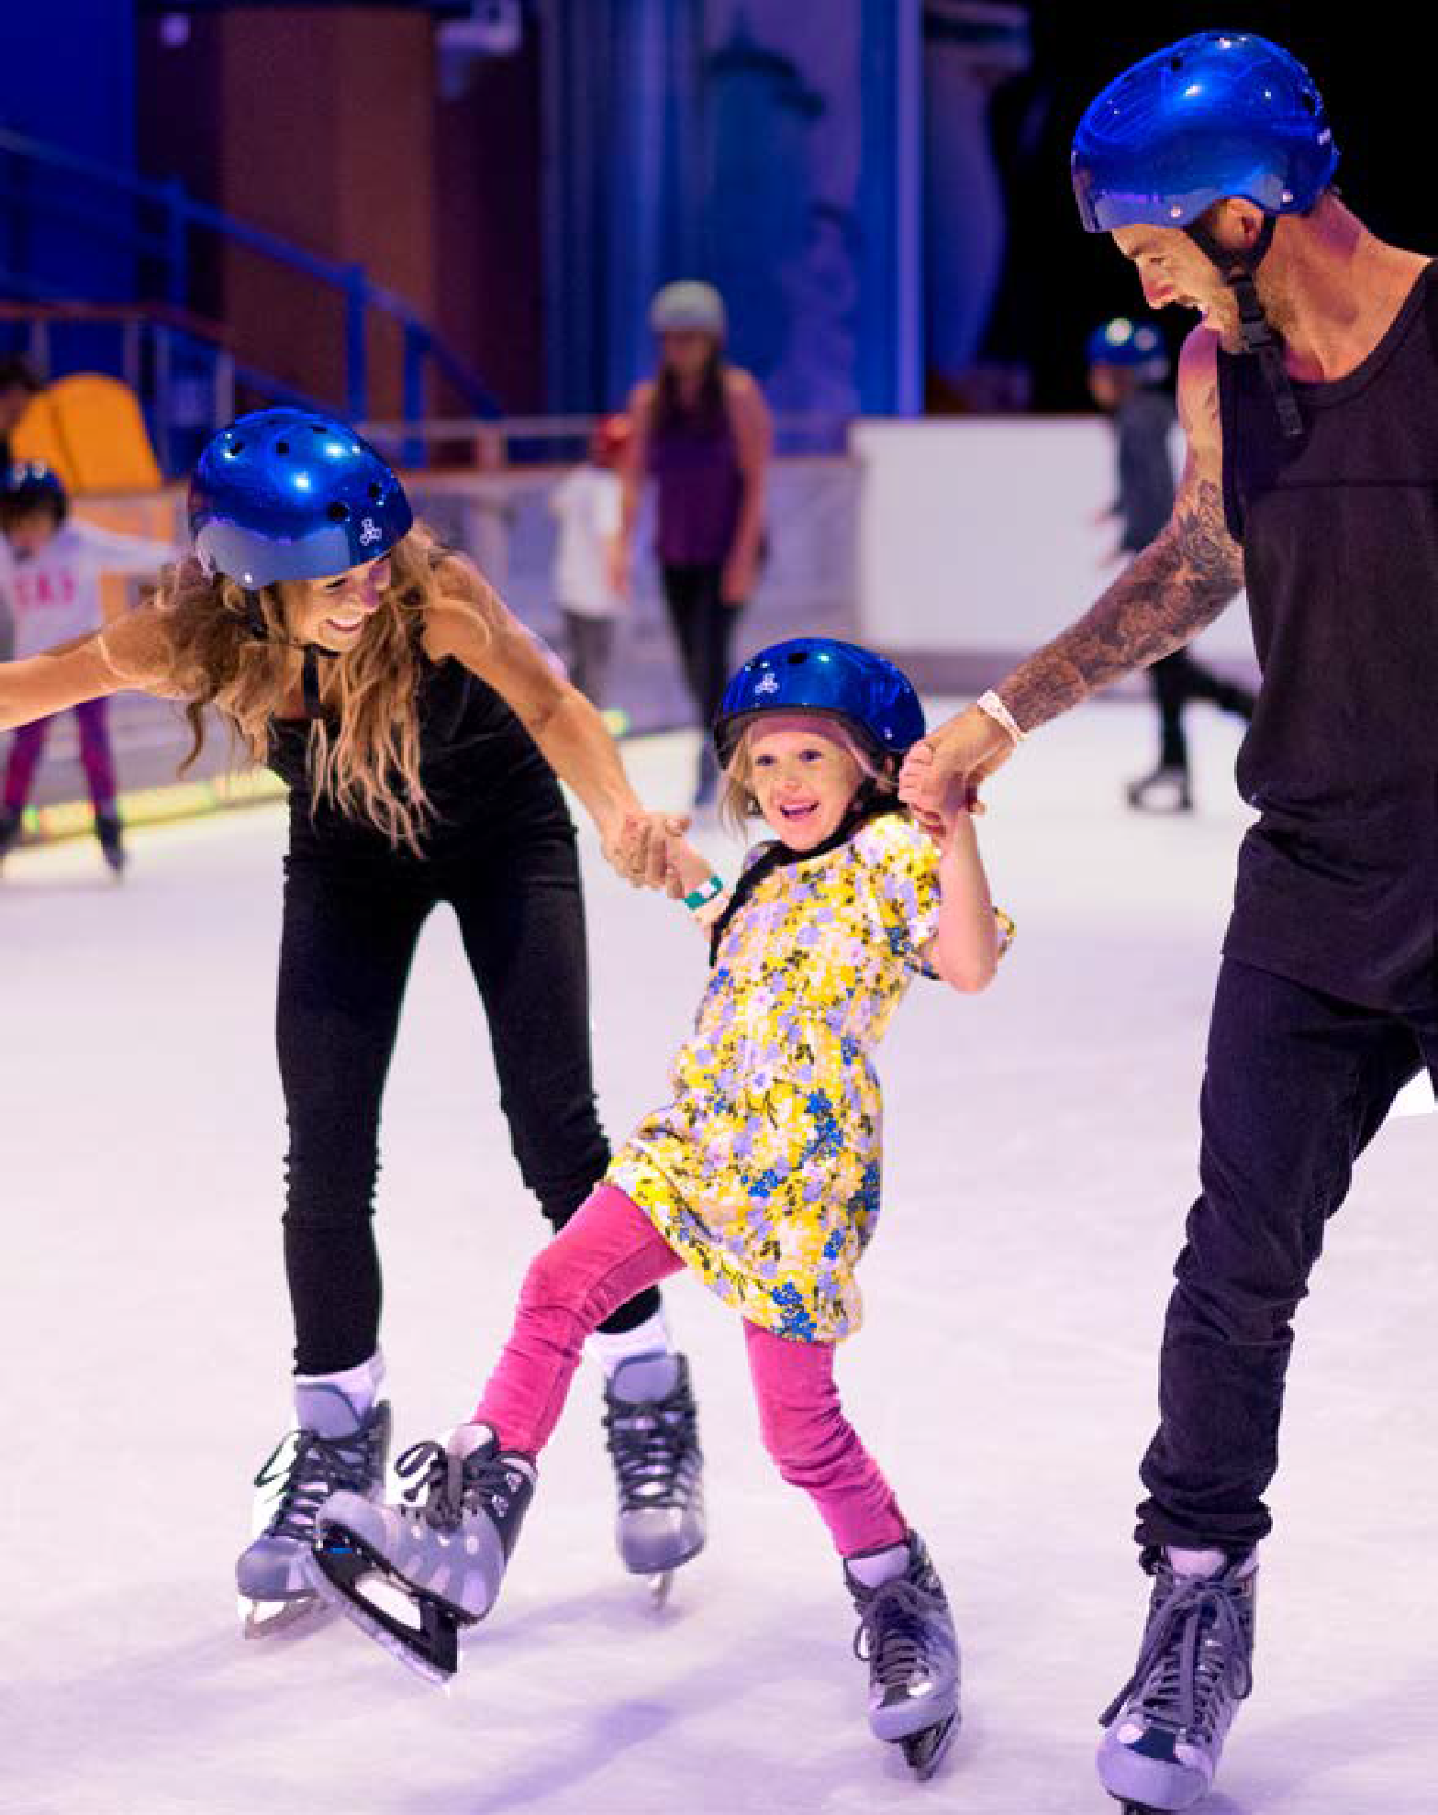
Ice Skating in Studio B — Allure of the Seas® | Asset ID 35256
N o . 3
C AMP AIGN ELEMENTS >> T ONE GUID ANCE >> BOD Y COP Y
W R I T I N G B O D Y C O P Y
Body copy should be distinctive, but
approachable. The tone is neither fancy
nor dumbed down. It conjures imagery and
moments. It’s purposeful but still descriptive.
Write as if you’re speaking to a friend about an unexpected adventure.
Avoid clichés and describing things the same old way.
Whether through clever turn of phrase or rich description, say things in fresh ways.
The language should be conversational.
Content may adjust for the audience, but our voice should remain consistent.

Slide 14
B R A N D C O P Y E X A M P L E S
N o . 3
C AMP AIGN ELEMENTS >> T ONE GUID ANCE >> BOD Y COP Y
FOR CURRENT TRADEMARKS IN USE B Y R O YAL C ARIBBEAN, VISIT
WriteItRoyal.com
SHIP FOCUSED
WHY IT W ORKS
The copy opens with a Come Seek pillar. What follows is a string of colorful,
unexpected phrases that convey energy in a unique way, like “memory maxing” and “edge-of-your-seat-inducing”. Also be sure to close with a brand statement about
the ship, or an invitation to Come Seek the Royal Caribbean.
Ship focused
This is not a cruise. This is a perception remixing, memory maxing mic drop. It’s adrenaline amping thrills. Edge-of-your-seat-inducing entertainment. And dining that hits all the high notes.
This is Symphony of the Seas®.
DESTINATION FOCUSED
WHY IT W ORKS
Focusing on destination, this copy opens with “This is not the Caribbean,” another Come Seek pillar. Phrases like “Piton peaking” and “rainforest
roaming” use alliteration to add some brand personality.
Destination focused
This is not the Caribbean. This is Piton peaking in St. Lucia, and
rainforest roaming in St. Kitts. Bonaire flamingo bonding, and natural bridge bounding in Aruba. Come Seek the Royal Caribbean®.
EMOTIONAL FOCUS
Destination + Ship focused
Sometimes, you have to disconnect to reconnect. Go for bolder bonding with the ones you love most on a whale shark dive in Cozumel. Link up
with locals to learn how to dance salsa in San Juan, Puerto Rico. Fuel your competitive side onboard with glow-in-the-dark laser tag or share the thrill of racing to the bottom of the tallest slide at sea. Open yourself up to new adventures — and discover why Royal Caribbean was voted Best Overall
16 years running by Travel Weekly. Come Seek the Royal Caribbean®.
WHY IT W ORKS
This copy delivers on our Phase Three strategy, drawing on emotive language to tell a deeper, richer story — but never sacrificing the
energy or vibrancy that has been our campaign’s calling card.

Slide 15
R E T A I L C O P Y E X A M P L E S
N o . 3
C AMP AIGN ELEMENTS >> T ONE GUID ANCE >> BOD Y COP Y
FOR CURRENT TRADEMARKS IN USE B Y R O YAL C ARIBBEAN, VISIT
WriteItRoyal.com
Retail promotions drive a large portion of our business, and communicating offers requires balance.
Always highlight the value of the offer, but never make us sound tacky. We want to be sure we maintain the brand tone so we don’t lose our greatest selling point — one-of-a-kind, unforgettable adventures — in lieu of a value opportunity.
CAMPAIGN PILLAR
WHY IT W ORKS
This example leans into one of our Come Seek pillars (This is not a
cruise) and builds off of it using colorful language. Offer language is woven in in a way that still conveys energy through brand-appropriate word choice. When explaining offers, don’t bog down the body copy by listing each component — that’s what the lockup is for. Select any highlights or a component that may need further clarification.
Trade focused
This is not a cruise. This is making a break from the cold and into the bold. Right now, you can save big on a winter-ditching
getaway with 50% off your second guest — plus a bonus up to $100 to spend at sea on Anthem of the Seas®. Ask your travel advisor for more ways to save. Come Seek the Royal Caribbean®.
MU LT-COMPONENT OFFER
Trade focused
You could scroll through memories. Or you can make your own. Get in
touch with your wild side as you explore lush jungle trails in Belize — then discover the depths of your courage onboard by plunging down the tallest slide at sea, Ultimate AbyssSM. You’ll save big on every adventure, because the WOW Sale is back. Book now and score up to $300 off your next
getaway, plus 50% off your second guest. And bring the whole family, because kids sail free.* Come Seek the Royal Caribbean®.
WHY IT W ORKS
Similar to the brand example on the previous page, this retail copy delivers on our Phase Three strategy by tapping into the emotional benefits of adventure. Notice that it does so with a lighter touch in order to make the transition into offer language feel natural — too emotional and it could get jarring.
15

Slide 16
T R A D E F A C I N G C O P Y E X A M P L E S
N o . 3
C AMP AIGN ELEMENTS >> T ONE GUID ANCE >> BOD Y COP Y
FOR CURRENT TRADEMARKS IN USE B Y R O YAL C ARIBBEAN, VISIT
WriteItRoyal.com
Travel agents, whom we should always address as travel partners, are a critical part of our business. So it’s
important to keep them well informed of our latest promotions and news — and to show appreciation for selling
their clients on our product. Because of their expertise, you should prioritize information differently. For example, there’s no point in describing Caribbean locales to someone who’s been selling that product for years.
MARKETING FOCUSED
Trade focused
WHY IT W ORKS
When marketing to travel partners, keep in mind that — though they may need a vacation of their own — this product is for their clients, not them. Again, destination is their business and they know it well, but feel free to be descriptive of ship features.
This is not a cruise. This is the Caribbean adventure of a lifetime onboard the world’s most incredible ships. It’s
The Perfect StormSM waterslide trio, family fun by the gallon at
Splashaway BaySM, and dining that takes your clients from Italy to Wonderland. All while exploring the Caribbean’s best shores.
APPRECIATION FOCUSED
Trade focused
WHY IT W ORKS
Frequently we let travel partners know just how grateful we are for their business. This should convey appreciation for their loyalty to the brand, and focus on our shared success.
We’ve got plenty to celebrate this holiday season, and there’s no one we’d rather share it with than you and your clients.
We couldn’t have done it without your passion for crafting one-of-a-kind experiences and entrusting those experiences
to Royal Caribbean. Here’s to a new year filled with adventure.

Slide 17
T H E T O P I C O F C T A s
N o . 3
C AMP AIGN ELEMENTS >> T ONE GUID ANCE >> C ALL S T O A C TION
CTAs are how we urge the reader to take the action we’re trying to drive. It can be direct, or it may feature a bit of brand tone, but
remember that clarity is key.
CTA EXAMPLES
Standard 3-part CTA
Call us at 1-800-Royal-Caribbean Visit RoyalCaribbean.com
Contact your travel advisor
CTA’s should have a maximum of 3 parts when Royal Caribbean speaks directly to consumers.
There is flexibility in determining which CTA style works for a particular communication — or if a CTA is necessary in a particular piece of work.
Trade collateral CTA
Contact your travel advisor today.
Enter Agency Name Here Enter phone and/or email
Trade collateral typically only drives to the agency, and we
provide editable fields for travel partners to insert their info.
Avoid using “www.” in URLs — and be sure to initial cap your URL to help with ease of reading.
Visit www.royalcaribbean.com Visit RoyalCaribbean.com

Slide 18
N o . 3
C AMP AIGN ELEMENTS >> T ONE GUID ANCE >> ADDRESSING TRAVEL P AR TNER S
CONSUMER FACING
A D D R E s s I N G
T R A V E L P A R T N E R s
We’ve already mentioned the importance of travel partners to our business — for many
consumers they’re the first step in booking a vacation. To show our appreciation and respect for these dedicated individuals, we no longer
call them agents and instead use standardized language when speaking of them or to them.
Travel Advisor
This is the title we use any time we’re referring to
travel agents in a communication to consumers or guests.
Consumer Facing Example
Contact your travel advisor to book your adventure today
TRADE FACING
Travel Partner
When speaking directly to travel agents, we want to use this title to acknowledge their partnership in helping us deliver great vacations to their clients.
Trade Facing Example
Royal Caribbean is celebrating 50 years
of big, bold adventures — and appreciation for you, our valued travel partners.

Slide 19
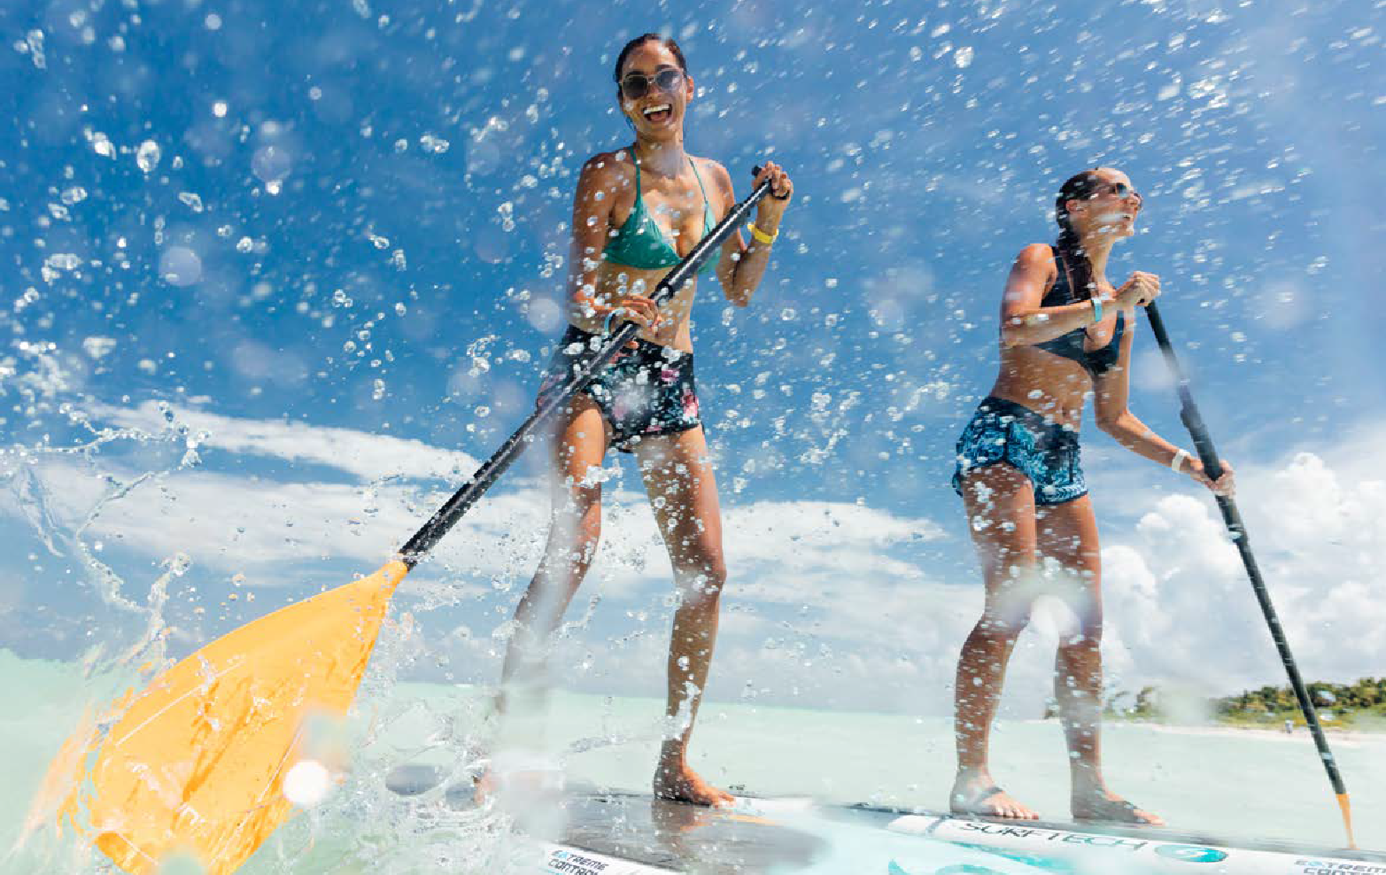
Cozumel, Mexico | Asset ID 38276
N o . 3
C AMP AIGN ELEMENTS >> DESIGN
C A M P A I G N E L E M E N T S
F O R M U L A F O R D E S I G N

Slide 20
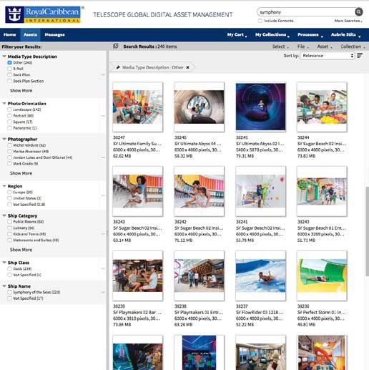
O N L I N E D I G I T A L L I B R A R Y
N o . 3
C AMP AIGN ELEMENTS >> DESIGN >> DIGITAL A SSET LIBRAR Y
All assets featured in the campaign guidelines are available on our Digital Library at RCCLLibrary.com.
Here you can browse, preview, download and share
assets. Below are some quick tips to get you started.
Registration
From the login page, click the Self Registration button and complete the form. Then scroll to read the User Agreement and check the box to confirm you agree to the terms. A temporary password will be emailed to you shortly.
Access
Go to RCCLLibrary.com, click the Royal Caribbean logo and log in using your Digital Library username and password.
Search Options
There are multiple ways to search for the assets you need.
KEYWORD SEARCH
To use the Keyword Search, type in some descriptive words (ex. “Harmony
Flowrider”) in the text field in the upper right and click the magnifying glass icon.
FILTER YOUR RESULTS
For a broader search, you can Filter Your Results by clicking Assets, the second tab in the top left navigation bar. Here you can curate results by media type,
region, ship names and ship categories.
ASSET IDs
Lastly, you can search by any Asset ID number, many of which are referenced in these guidelines.
RCCLLibrary.com is intended for internal use only.

Slide 21





N o . 3
C AMP AIGN ELEMENTS >> DESIGN >> COME SEEK L OCKUP
‘COME SEEK’ HOLDS
A REGISTRATION MARK
✪ RECOMMENDED TRE ATMENT
The preferred way to represent this in marketing is by including the following trademark statement in the terms and conditions, which eliminates the need to use ® in copy or on the lockup.
Come Seek is a registered trademark of Royal Caribbean.
Asset ID 27293
HORIZ ON TAL L OCK UP ( WITHOUT ®)
DO NOT A LTER THE INTEGRITY OF THE LOCKUP
C O M E S E E K L O C K U P
The Come Seek lockup is big and bold, making it a strong visual branding
element. It is often used in upper funnel touchpoints, like brand ads and out of home.
Download all logos at RCCLLibrary.com
HORIZONTAL MINIMUM SIZE
Do not reproduce the logo smaller than the following:
Digital 240 px x 57px | Print 3.3” x 0.78”
Asset ID 27292
VER TIC AL L OCK UP ( WITHOUT ®)
A LTERN ATE TRE ATMENT
If needed, you can place the ® symbol in copy or on the lockup instead.
Come Seek® the Royal Caribbean®
Horizontal Lockup with ®
Asset ID 44381
Vertical Lockup with ®
Asset ID 44381
VERTICAL MINIMUM SIZE
Do not reproduce the logo smaller than the following:
Digital 120 px x 251px | Print 1.7” x 3.5”
L OCKUP COL OR S
WHITE
For use over photographic or colored backgrounds, such as in OOH, posters and ads.
GR AY OR NAVY
For use on white backgrounds. Do not use on photographic backgrounds — rather retouch the
image to address any legibilty concerns.

Slide 22



N o . 3
C AMP AIGN ELEMENTS >> DESIGN >> COME SEEK L OCKUP
DO NOT A LTER THE INTEGRITY OF THE LOCKUP
LOCKUP COLOR
NEVER change the color of the lockup.
The lockup should only be used in white, navy or gray.
C O M E S E E K L O C K U P
The Come Seek lockup should always be used with the corporate logo, but should never replace it or be placed directly beside it in layout.
LOCKUP DESIGN
NEVER remove or rearrange parts of the lockup (whether in the horizontal or vertical version), or use any portion of the lockup in isolation.
Visit pages 56 & 64-68 for how to use the Come Seek lockup in layout.
LOCKUP PAIRING
NEVER place the Come Seek lockup and
corporate logo side by side in layout. But be sure to provide ample hierarchy and contrast
in size within the piece. See pages 56 & 64-68 for examples.
Download all logos at RCCLLibrary.com
LOCKUP LEGIBILITY
NEVER place the navy or gray Come Seek lockup over a photographic background.
Rather, the image should be retouched to
address any legibility concerns. If not possible, then an alternate image should be used.

Slide 23




















C O L O R P A L E T T E
Print
N o . 3 C AMP AIGN ELEMENTS >> DESIGN >> COL OR P ALETTE
RAINFORES T (GREEN)
OCEAN (BLUE )
HIBISCUS (PINK)
SUNRISE (YELL O W )
SUNSET (ORANGE )
C | 89 | C | 29 | C | 68 | C | 29 | C | 100 | C | 52 | C | 74 | C | 35 | C | 67 | C | 30 | C | 0 | C | 0 | C | 6 | C | 0 | C | 0 | C | 0 | C | 0 | C | 0 | C | 0 | C | 0
M | 19 | M | 1 | M | 0 | M | 2 | M | 90 | M | 0 | M | 55 | M | 9 | M | 95 | M | 100 | M | 100 | M | 75 | M | 35 | M | 22 | M | 16 | M | 4 | M | 95 | M | 77 | M | 76 | M | 51
Y | 72 | Y | 100 | Y | 71 | Y | 24 | Y | 0 | Y | 1 | Y | 0 | Y | 0 | Y | 4 | Y | 0 | Y | 24 | Y | 21 | Y | 99 | Y | 100 | Y | 65 | Y | 27 | Y | 94 | Y | 97 | Y | 100 | Y | 100
K | 60 | K | 18 | K | 18 | K | 3 | K | 55 | K | 0 | K | 0 | K | 0 | K | 16 | K | 20 | K | 4 | K | 0 | K | 18 | K | 2 | K | 0 | K | 0 | K | 28 | K | 15 | K | 0 | K | 0
PMS
343
383
7730
559
281
297
2125
277
520
7649
214
1915
1245
7549
141
7401
7620
7580
166
144

Slide 24




















C O L O R P A L E T T E
Web
N o . 3 C AMP AIGN ELEMENTS >> DESIGN >> COL OR P ALETTE
RAINFORES T (GREEN)
OCEAN (BLUE )
HIBISCUS (PINK)
SUNRISE (YELL O W )
SUNSET (ORANGE )
R | 4 | R | 168 | R | 20 | R | 173 | R | 29 | R | 60 | R | 72 | R | 113 | R | 77 | R | 153 | R | 211 | R | 239 | R | 199 | R | 249 | R | 255 | R | 255 | R | 154 | R | 183 | R | 227 | R | 237
G | 73 | G | 173 | G | 133 | G | 202 | G | 30 | G | 176 | G | 89 | G | 197 | G | 45 | G | 17 | G | 22 | G | 74 | G | 145 | G | 194 | G | 213 | G | 240 | G | 17 | G | 49 | G | 82 | G | 139
B | 53 | B | 0 | B | 52 | B | 184 | B | 83 | B | 224 | B | 163 | B | 232 | B | 125 | B | 84 | B | 116 | B | 129 | B | 27 | B | 10 | B | 115 | B | 195 | B | 21 | B | 44 | B | 5 | B | 0
HTML
115740
A8AD00
4B9560
ADCAB8
131E29
71C5E8
5461C8
ABCAE9
642F6C
8A1B61
CE0F69
EF4A81
C69214
FFB500
F2C75C
F5E1A4
B7312C
C05131
E35205
ED8B00

Slide 25
N o . 3
C AMP AIGN ELEMENTS >> DESIGN >> TYPOGRAPHY
T Y P O G R A P H Y
Fonts can be purchased at the following links
D AR WIN http://www.myfonts.com/fonts/los-andes/darwin/
KAPRA http://www.myfonts.com/fonts/blazej-ostoja-lniski/kapra/
HEADLINE FORMULA
SUBHEAD FORMULA
O N L Y W R I T E
SUBHEADS ARE SET IN
ALL C APS AND DAR WIN BOLD.
= x
=
H E A D L I N E S I N
TYPEFACE
COL OR
POINT SIZE
(+ 5)
LEADING
KERNING
DAR WIN BOLD
WHITE
NAVY BLUE
(on white background)
18
(+ 5)
23
150
W H I T E , A L L C A P S & K A P R A R E G U L A R
BODY COPY FORMULA
Body copy is set in Darwin Light on solid color backgrounds, and Darwin Regular
on photographic backgrounds, to aid legibility. Body copy should be left aligned.
In some cases, body copy that is 5 lines or less can be centered, with special
attention to keep ragging even while while avoiding dashes or numbers on margins.
TYPEFACE | COL OR | POINT SIZE | (+ | 5) | LEADING | KERNING
Darwin Light (on solid color backgrounds) Darwin Regular (on photographic backgrounds) | WHITE 85 % BLACK (on white background) | 10 | (+ | 5) | 15 | 40
TYPEFACE | COL OR | POINT SIZE* | LEADING | KERNING
K A P R A R E G U L A R | WHITE | 50 | The leading should be equal to the x height. | 200
*Font sizes for headline are based on an 8x10 ad and the sizes should be scaled proportionally.

Slide 26
T Y P O G R A P H Y
N o . 3
C AMP AIGN ELEMENTS >> DESIGN >> TYPOGRAPHY
Fonts can be purchased at the following links
D AR WIN http://www.myfonts.com/fonts/los-andes/darwin/ GO THAM https://www.typography.com/fonts/gotham/styles/
CALL TO ACTION FORMULA
PHOTO CAPTION FORMULA
Captions are set in Darwin Regular.
CTA is set in Darwin Bold
Our private destination, Labadee®
COL OR
POINT SIZE
LEADING
KERNING
Book your adventure at RoyalCaribbean.com
WHITE
Placed inside the hero.
N/A
Captions should not exceed one line.
The space between the dots and the CTA is equal to the x height of the CTA.
7
40
Captions should be written with initial caps and use em dashes to separate caption components such as destination from location or dish from food. (Ex. Arctic Mocha Roll — Jamie’s Italian by Jamie Oliver)
COL OR |  | STR OKE TYPE
LEADER DOTS FORMULA | WHITE | 1 _{PT} DOTTED
LEGAL COPY FORMULA
Legal is set in Gotham Condensed.
Length of both leader dot lines should be equal. Adjust the length as necessary based on layout. If the CTA extends to two lines, the leader dot lines should frame the top line.
Features vary by ship. ©2019 Royal Caribbean Cruises Ltd. Ships’ registry: The Bahamas.
COL OR | POINT SIZE | (+ | 5) | LEADING | KERNING
WHITE NAVY BLUE (on white background) | 12 | (+ | 5) | 17 | 75
COL OR | POINT | SIZE | LEADING | KERNING
WHITE 85 % BLACK (on white background) | 7 | 7 |  | 0

Slide 27
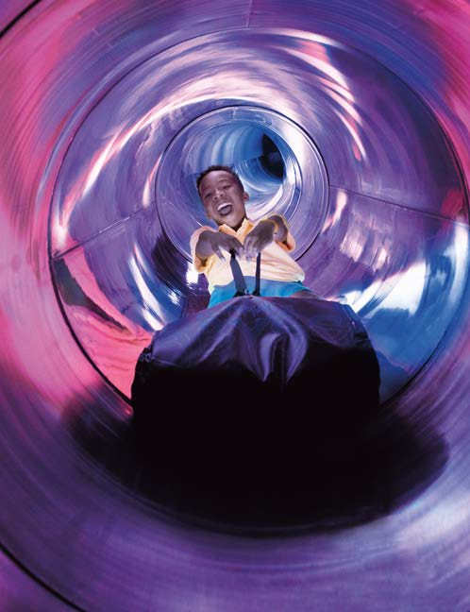
N o . 3
C AMP AIGN ELEMENTS >> DESIGN >> BORDER
F U L L B O R D E R
The cool thing about this design element is it allows us to reinforce the vibrancy of the
campaign while creating separation between our work and its environment.
See pages 55-56, 59-62 and 64-68 for examples of a full border in ads, flyers, posters and OOH.
Ultimate AbyssSM — Harmony of the Seas® | Asset ID 28663
DO NOT MIX COLOR FAMILIES OR A LTER ORDER OF BORDER COLORS
COL OR BORDER
WHITE STR OKE
=
The color border and
BORDER
0. 125 ” 9 pt
FORMULA
white stroke should always match in width.
Width of color border and white stroke should always match. These sizes are based
BORDER COLOR ORDER
Color flows from left to right, light to dark.
BORDER COLOR SELECTION
The border color family should complement the photography it surrounds.
on an 8x10 ad and may need to be scaled appropriately.

Slide 28

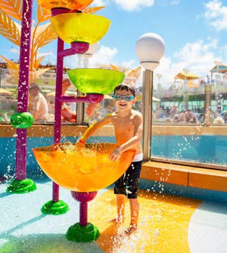

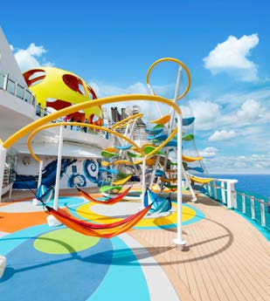

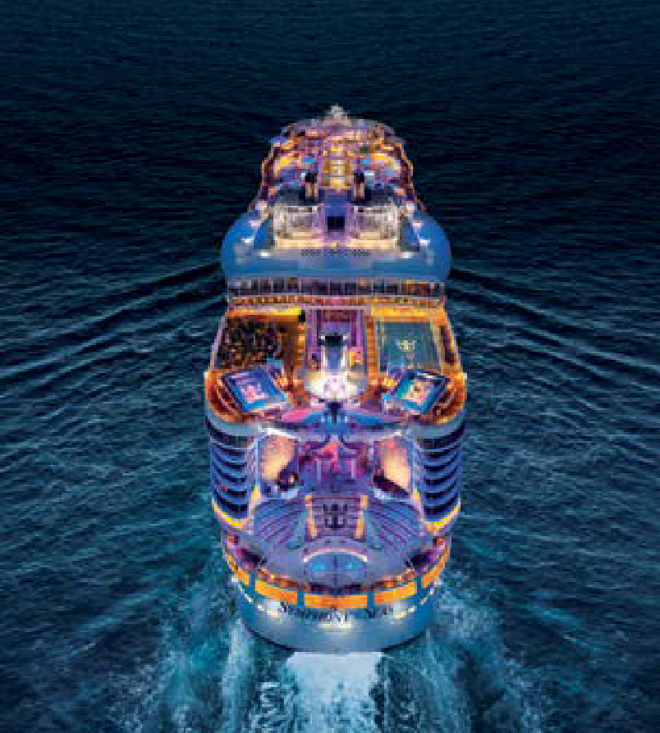


F U L L B O R D E R U S A G E
N o . 3
C AMP AIGN ELEMENTS >> DESIGN >> BORDER
COLOR FAMILIES
NEVER mix Come Seek color families. Borders should be built from one family only so they don’t distract
from the star of the show — our photography.
BORDER ORDER
Consistency is key. NEVER rearrange or alter the order of the border colors. Please refer to page 27 for the
correct color order.
BORDER DESIGN
The color border and white border should be equal in width and height. All four color quadrants should be equal in height.
Splash Pad — Navigator of the Seas® | Asset ID 44197
Sky PadSM — Mariner of the Seas® | Asset ID 40022
Symphony of the Seas® | Asset ID 42162
PICK ONE
=
=

Slide 29
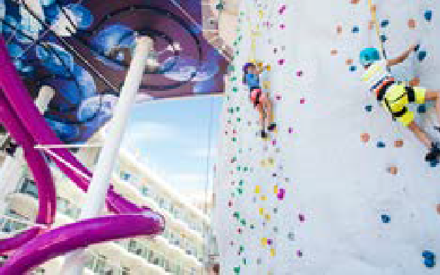
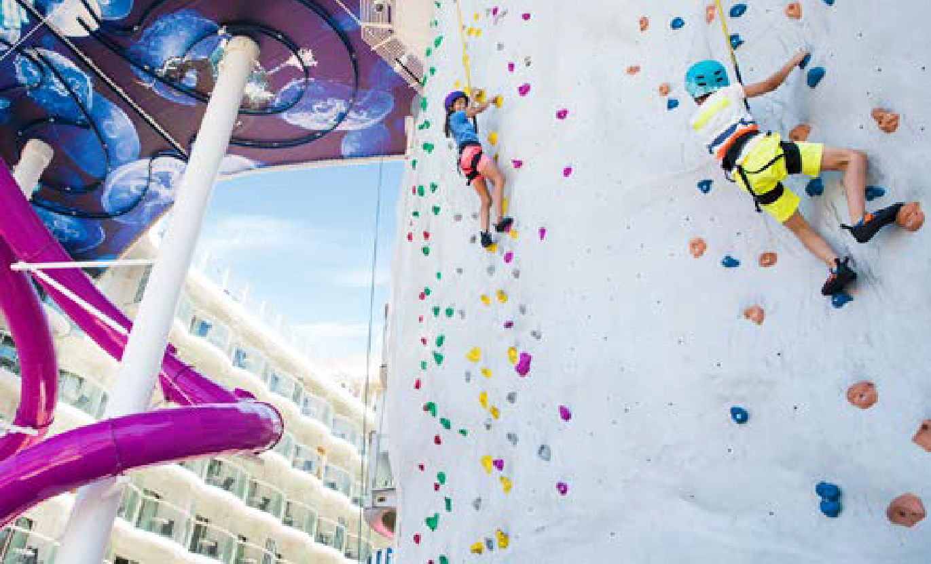
N o . 3
C AMP AIGN ELEMENTS >> DESIGN >> BORDER
For horizontal ads,
the colorblock moves to the right of the hero image with the quarter borders underneath.
Rock Climbing Wall
Harmony of the Seas®
Asset ID 28877
Q U A R T E R B O R D E R
W I T H C O L O R B L O C K
We developed the quarter border so we could keep our unique branding element even in
spaces where the full border doesn’t work.
Go to pages 57-59 and 61 for examples of the quarter border in layout.
IMAGE ≥ COLOR BLOCK
The height of the color block (or width for horizontal ads) should never be
greater than the height of hero image.
DO NOT MIX COLOR FAMILIES OR A LTER ORDER OF BORDER COLORS
DO NOT USE YELLOW FOR COLOR BLOCKING DUE TO LEGIBILITY
CONCERNS
The top color border and bottom color
border should always match in height.
The quarter border may be used with or without the colorblock, but the colorblock
shouldn’t be used without the quarter border.
TO P COL OR BORDER |  | BO TT OM COL OR BORDER
BORDER FORMULA | 0. 125 ” | 0. 125 ”
BORDER COLOR ORDER
The main triangle color on
color palette page 23 should fill the color block.
=
COLOR BLOCK
Height of both top and bottom should be equal. These sizes are based on an 8x10 ad and may need to be scaled appropriately.
BORDER COLOR SELECTION
The border color family should complement the photography it surrounds.
QUARTER BORDER
=
Bottom color borders width should match.
29

Slide 30
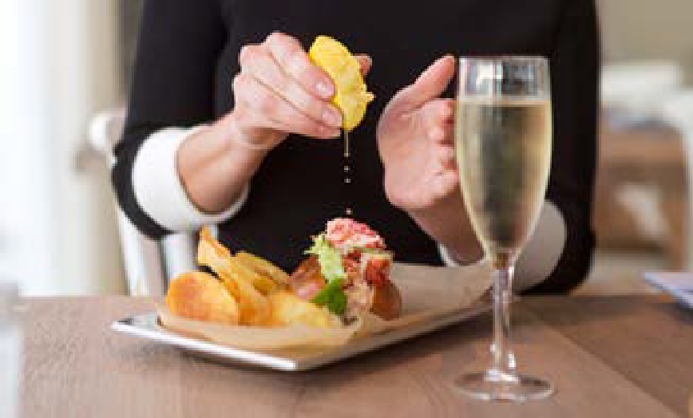
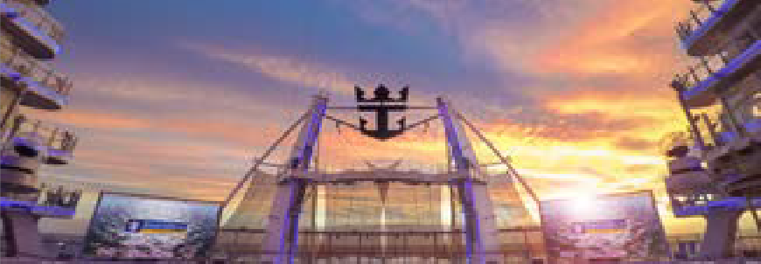
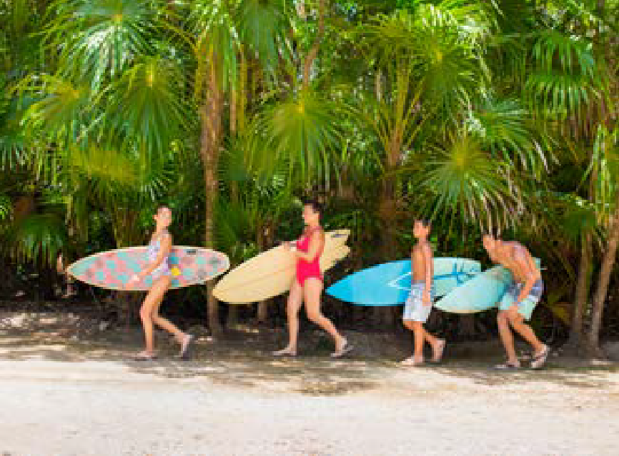
Q U A R T E R B O R D E R A N D C O L O R B L O C K U S A G E
N o . 3
C AMP AIGN ELEMENTS >> DESIGN >> BORDER
COLOR BLOCK COPY LEGIBILITY
NEVER use the yellow color family to build a color block — it makes it really hard to read the copy.
COLOR BLOCK PROPORTIONS
Our photography is the hero of our story. Make sure
the image is always greater than (or at least equal to) the color block.
COLOR BLOCK PLACEMENT
The color block should always go below (for vertical
designs) or to the right (for horizontal layouts). We are telling a story and want to lead with our imagery.
Hooked SeafoodSM | Asset ID 38794
AquaTheater — Harmony of the Seas® | Asset ID 32154
Cozumel, Mexico | Asset ID 51925
IMAGE
is equal to
IMAGE
is greater than
IMAGE
above
IMAGE
to the left of
COLOR BLOCK
USE
THESE
COLOR BLOCK
OR
COLOR BLOCK
OR
COLOR BLOCK
Vertical Layout
Horizontal Layout
30

Slide 31
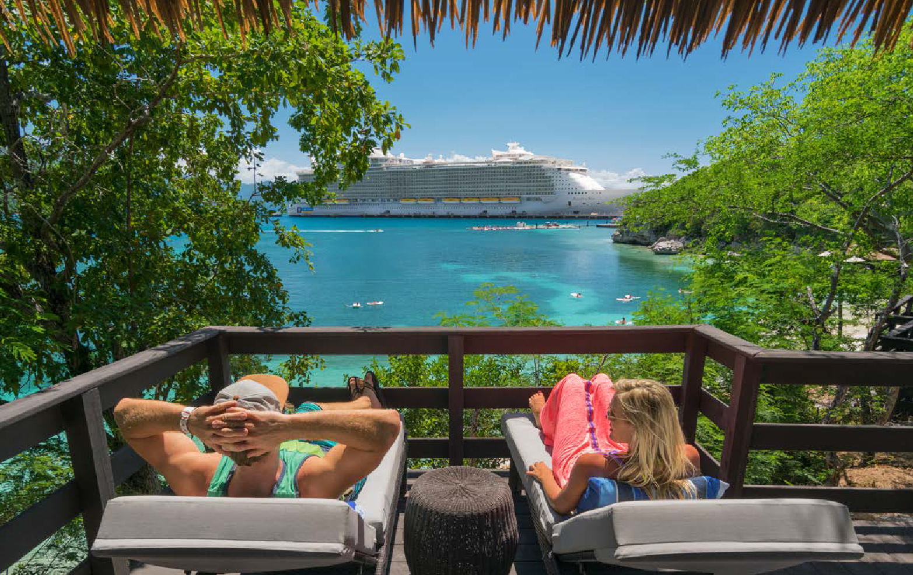
Labadee®, Haiti | Asset ID 35248
N o . 3
C AMP AIGN ELEME NTS >> PHO T OGRAPHY
C A M P A I G N E L E M E N T S
P H O T O G R A P H Y

Slide 32
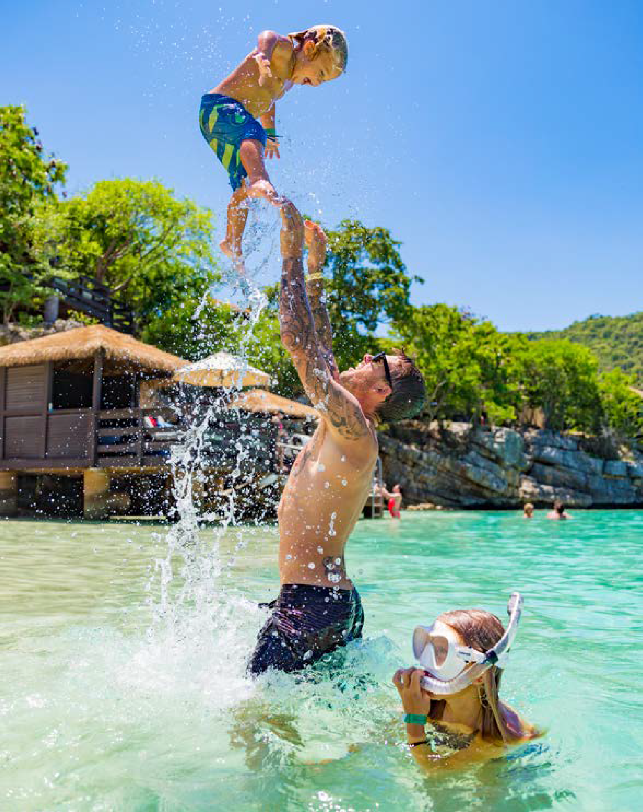
Labadee®, Haiti | Asset ID 35244
N o . 3
C AMP AIGN ELEMENTS >> PHO T OGRAPHY
P H O T O G R A P H Y
We can’t tell our brand story without incredible imagery. It is the most defining element of any strong Come Seek advertisement. Photography relies on a modern aesthetic, including
GoPro-style imagery, unique angles, and
distinctive cropping to create visual interest.
Download brand photography at RCCLLibrary.com
Captions
Captions allow us to make settings immediately recognizable,
and also add to the authenticity of our destination photography. We should caption imagery in all the following instances:
Distinctive location shot that makes the reader ask “Wow, where is that?”
Only on Royal features; shipboard experiences and venues
Pictures of our ships themselves
Food images (name of dish and restaurant)
Imagery captured by influencers, crew or guests, where attribution would show authenticity

Slide 33

Splashaway BaySM — Harmony of the Seas® | Asset ID 27851
N o . 3 C AMP AIGN ELEMENTS >> PHO T OGRAPHY
S H O W
E M O T I O N
If the viewer can relate to what the subject is feeling,
the photography is doing its job.

Slide 34
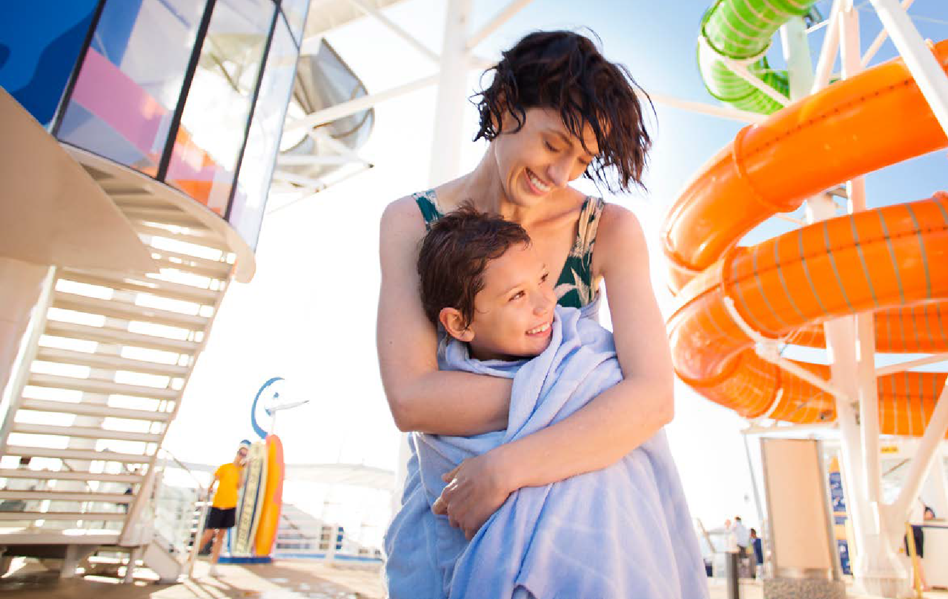
The Perfect StormSM — Liberty of the Seas® | Asset ID 24691
N o . 3 C AMP AIGN ELEMENTS >> PHO T OGRAPHY
C A P T U R E A U T H E N T I C
M O M E N T S
Say goodbye to posed pictures and
hello to candid moments that place the viewer in the heart of the experience.

Slide 35
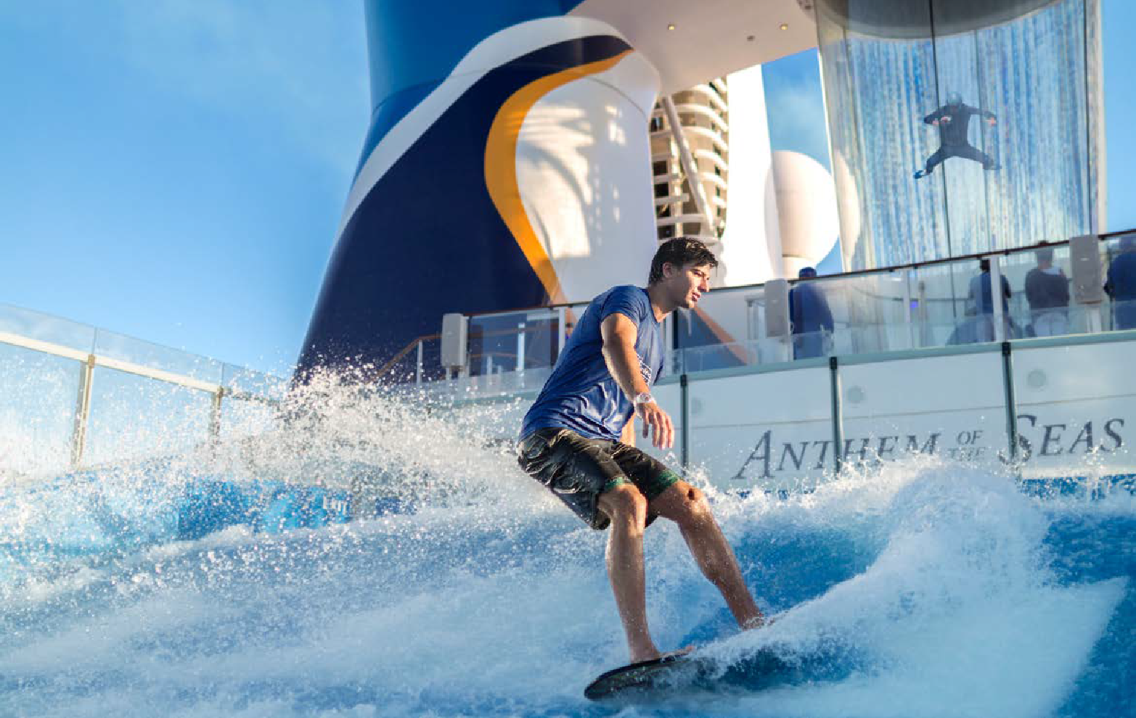
FlowRider® Surf Simulator and RipCord® by iFLY® | Asset ID 37642
N o . 3 C AMP AIGN ELEMENTS >> PHO T OGRAPHY
F O C U S
O N U N I Q U E
E X P E R I E N C E S
Whether it’s one of countless
Royal Caribbean innovations or cultural
immersion, surprise the viewer with things they likely haven’t experienced.

Slide 36
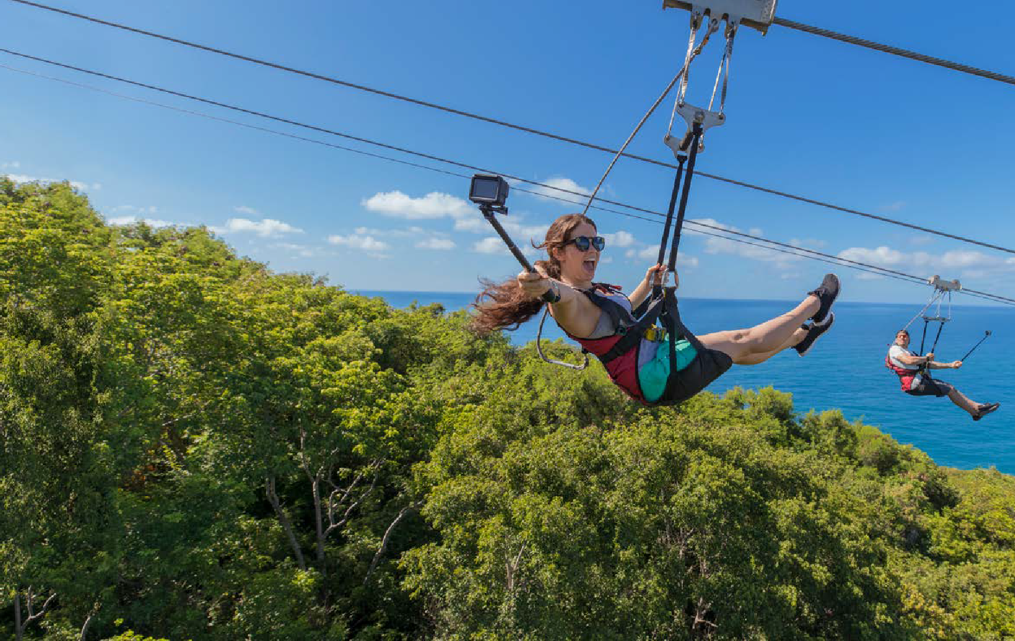
Labadee®, Haiti | Asset ID 36438
N o . 3 C AMP AIGN ELEMENTS >> PHO T OGRAPHY
B E I N O N
T H E A C T I O N
Imagery that takes the viewer along with the subject is a great way to allow
them to experience the moment.

Slide 37
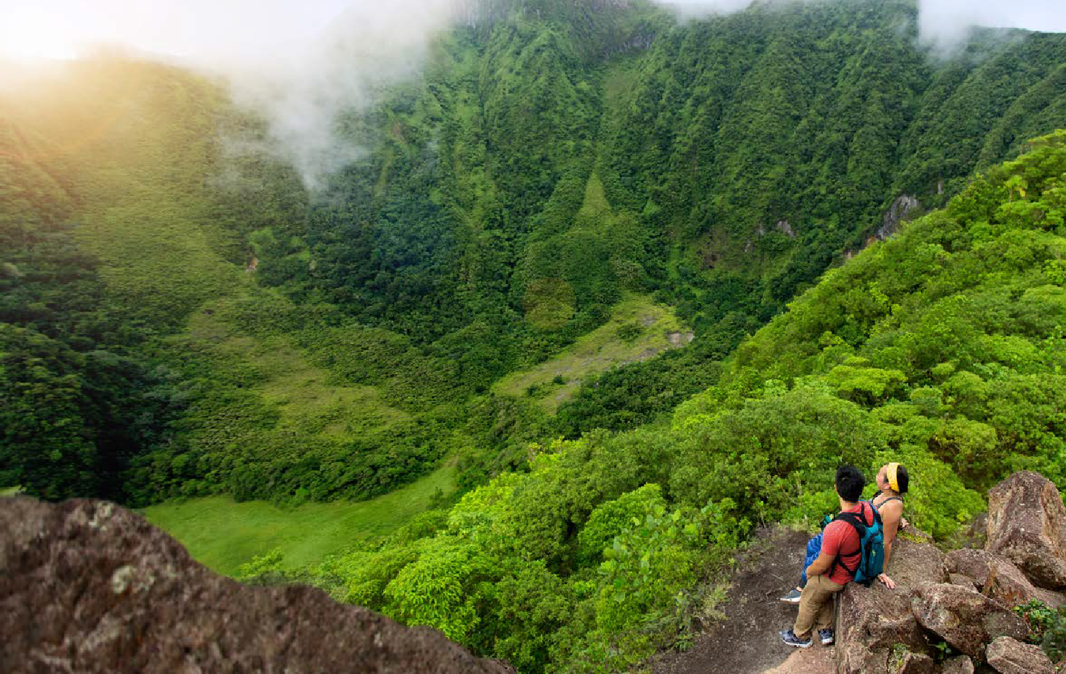
Mt. Liamuiga, St. Kitts | Asset ID 27286
N o . 3 C AMP AIGN ELEMENTS >> PHO T OGRAPHY
S H O W C A S E P E A K
D I S C O V E R Y
A big part of Come Seek is exploring, and a great way to depict that is through imagery that lets the viewer in on the moment when the subjects discover something new.

Slide 38
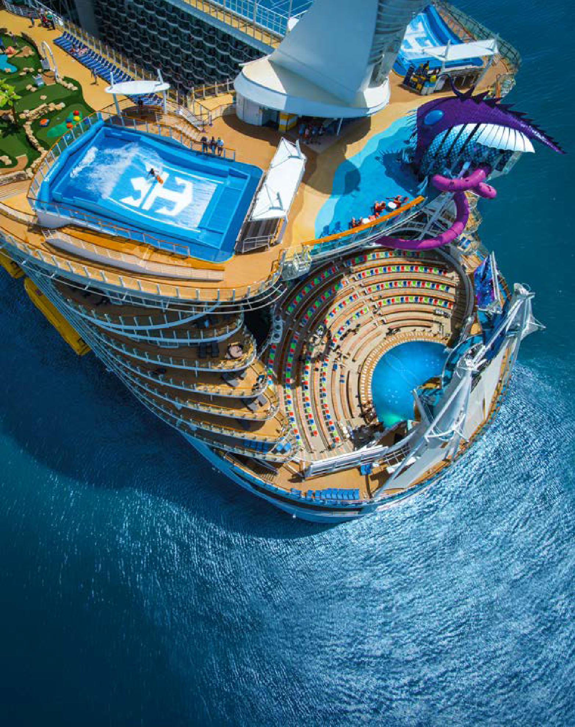
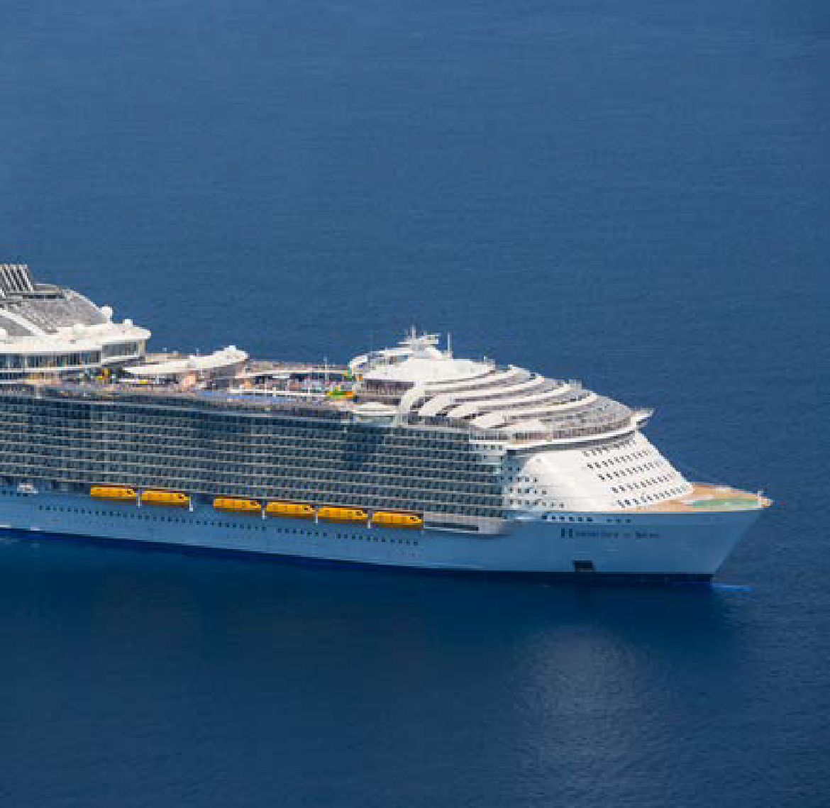
Harmony of the Seas® | Asset ID 28669
N o . 3 C AMP AIGN ELEMENTS >> PHO T OGRAPHY
SHIP IMAGER Y
If we want to break out of that big white ship cliché, one good
place to start is ditching the traditional shots of a big white ship at sea. To stand out from our competitors, choose ship imagery that highlights unique architecture and “only on Royal” features.
DO NOT USE generic ship images that don’t
highlight unique features, coastlines and angles.

Slide 39
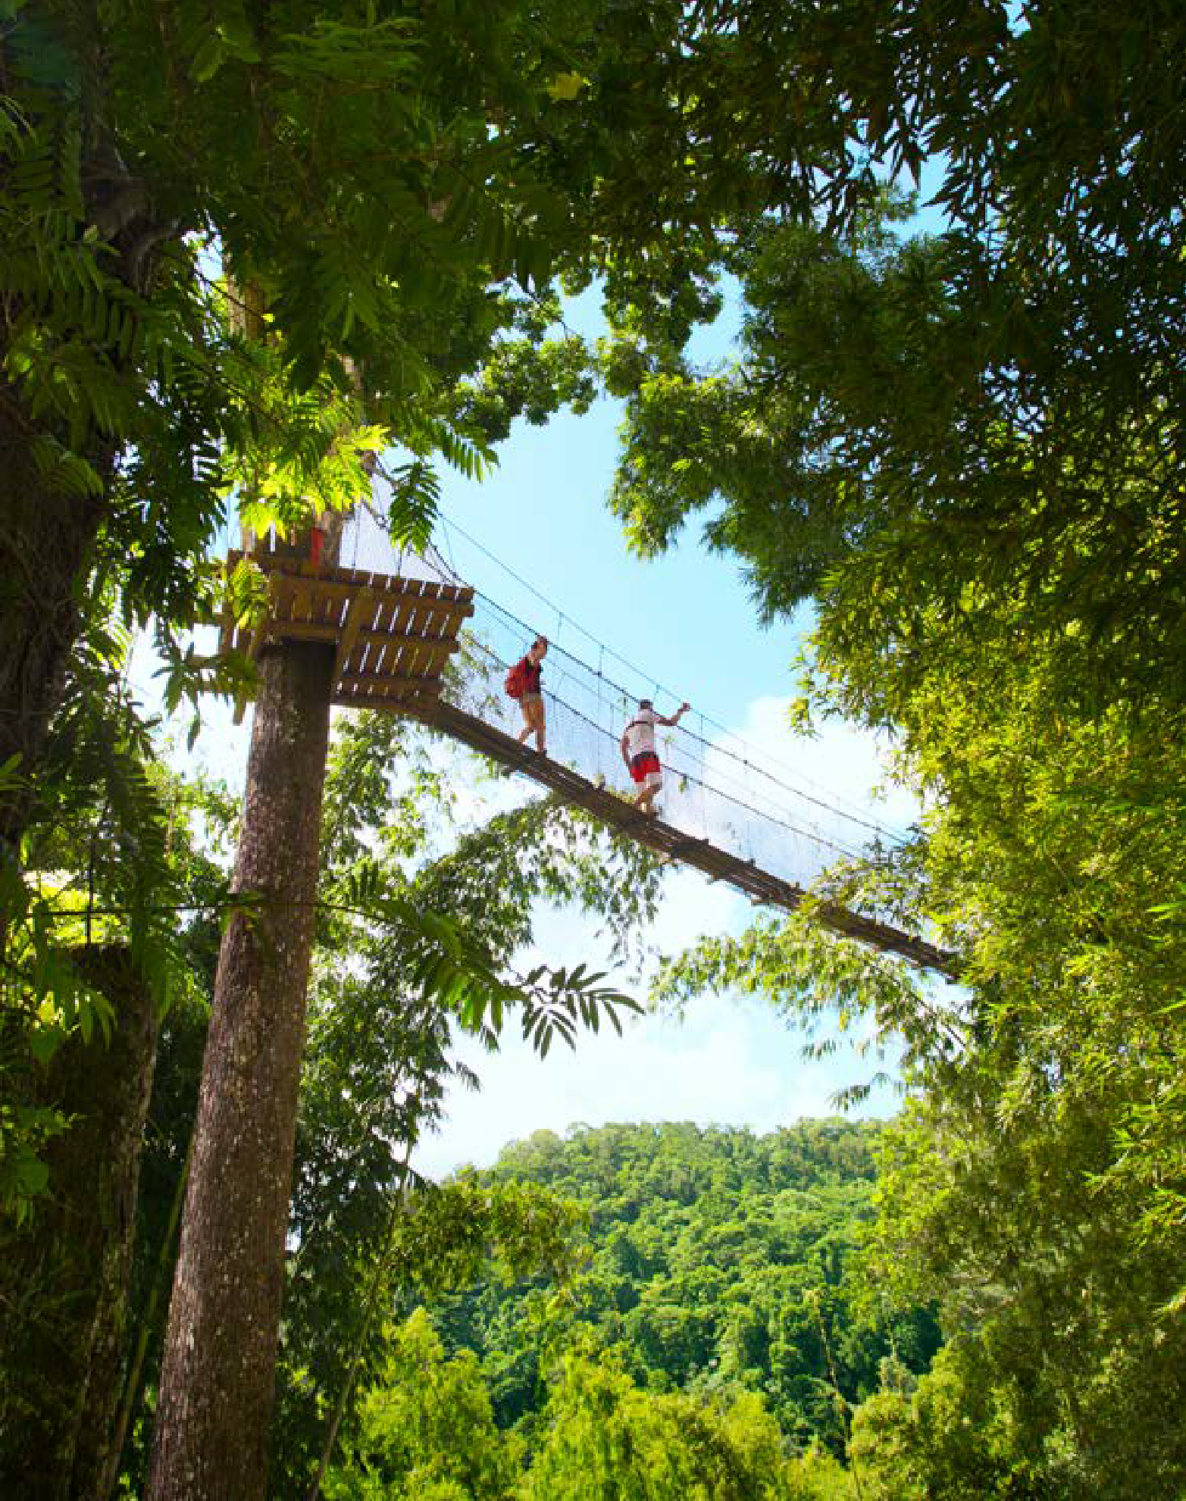
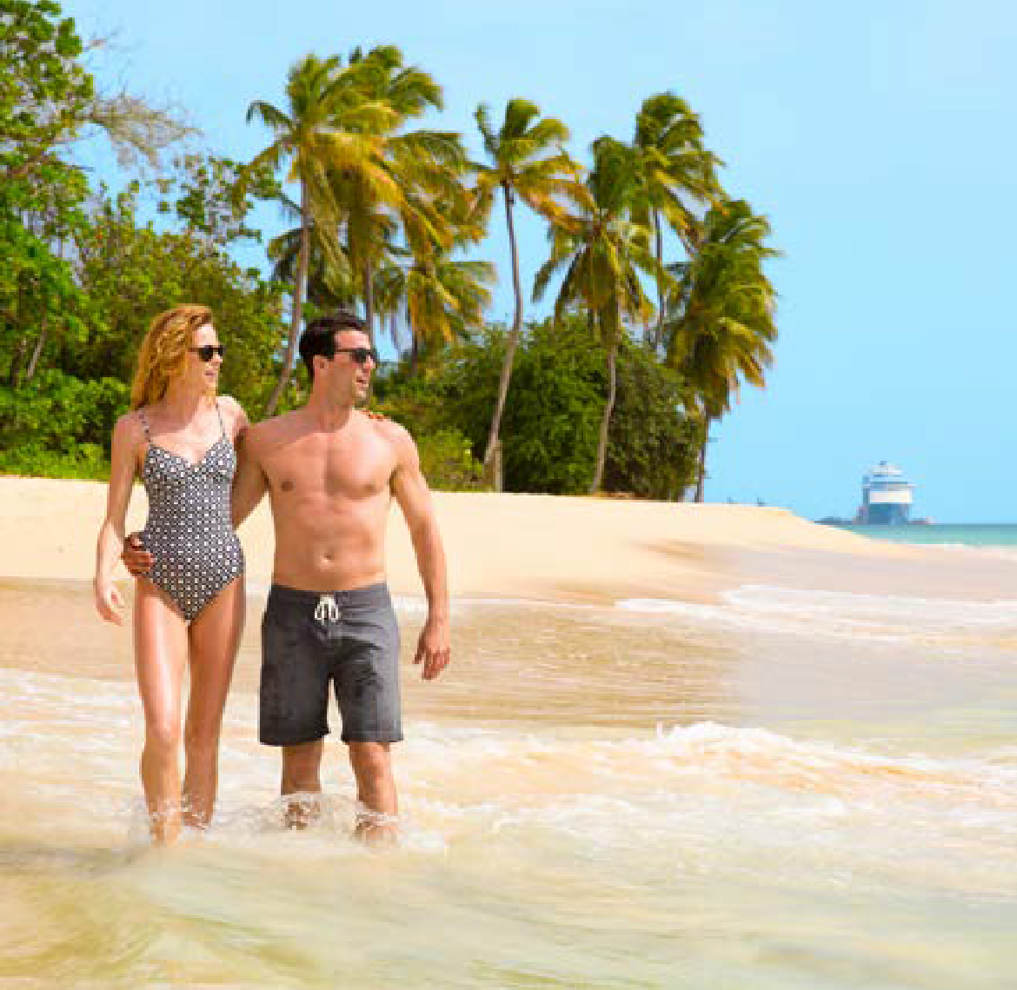
Balata Gardens, Martinique | Asset ID 24601
N o . 3 C AMP AIGN ELEMENTS >> PHO T OGRAPHY
DESTIN ATION IMAGER Y
Generic: bad. Distinctive: good. Focus on unique, authentic experiences and places rather than locations with no
distinguishing features.
DO NOT USE generic, expected settings, like a beach that could be anywhere.

Slide 40
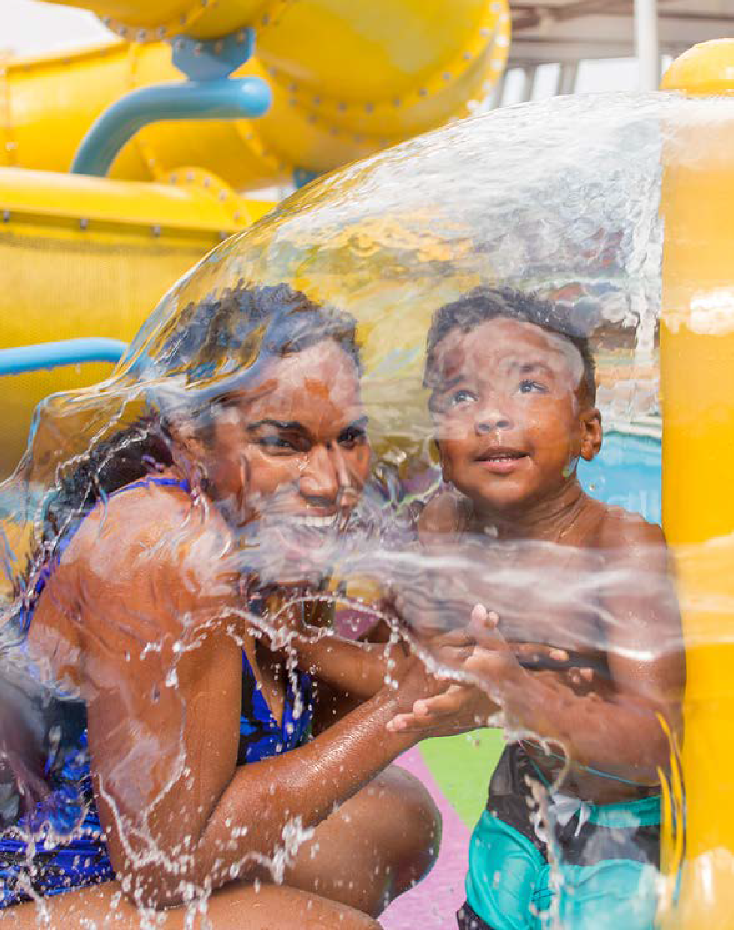
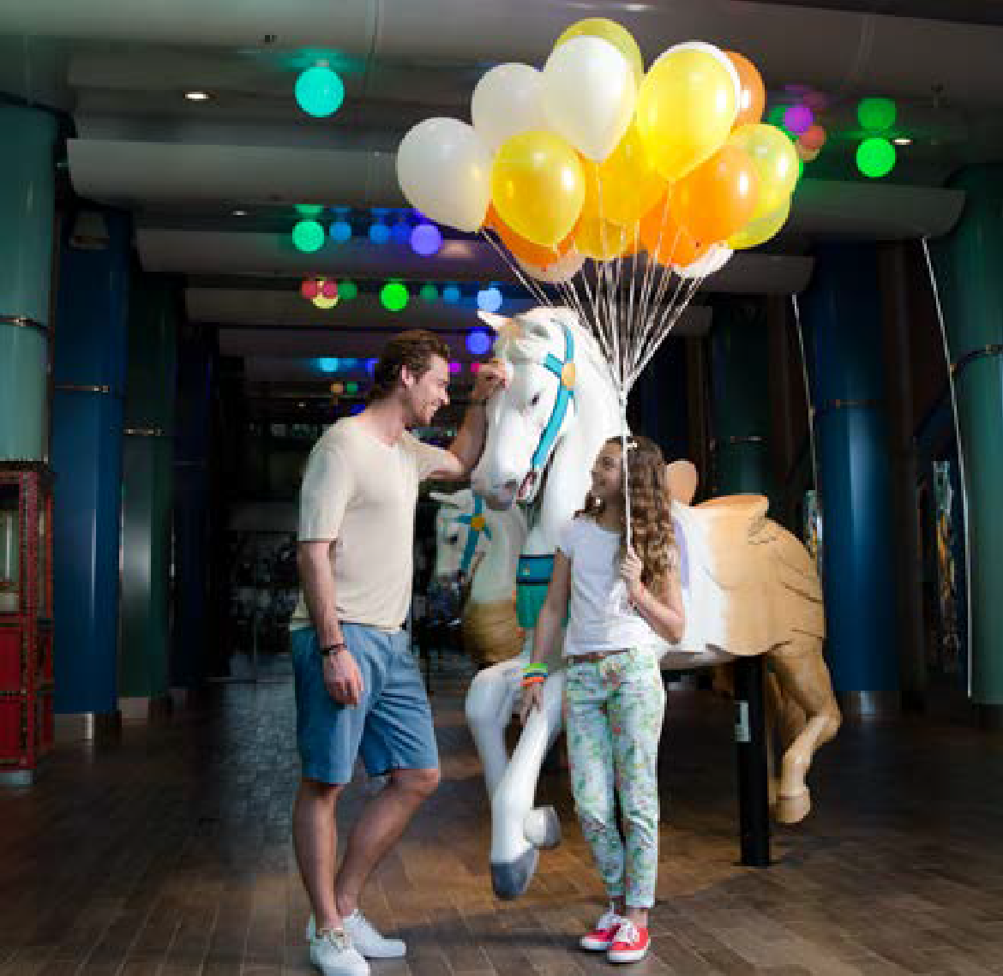
Splashaway BaySM — Harmony of the Seas® | Asset ID 29127
N o . 3 C AMP AIGN ELEMENTS >> PHO T OGRAPHY
FAMI LY IMAGER Y
To maximize impact, skip the posed subjects and
instead focus on families that feel like real families sharing realistic moments.
DO NOT USE overtly staged or unrealistic shots and subjects.

Slide 41
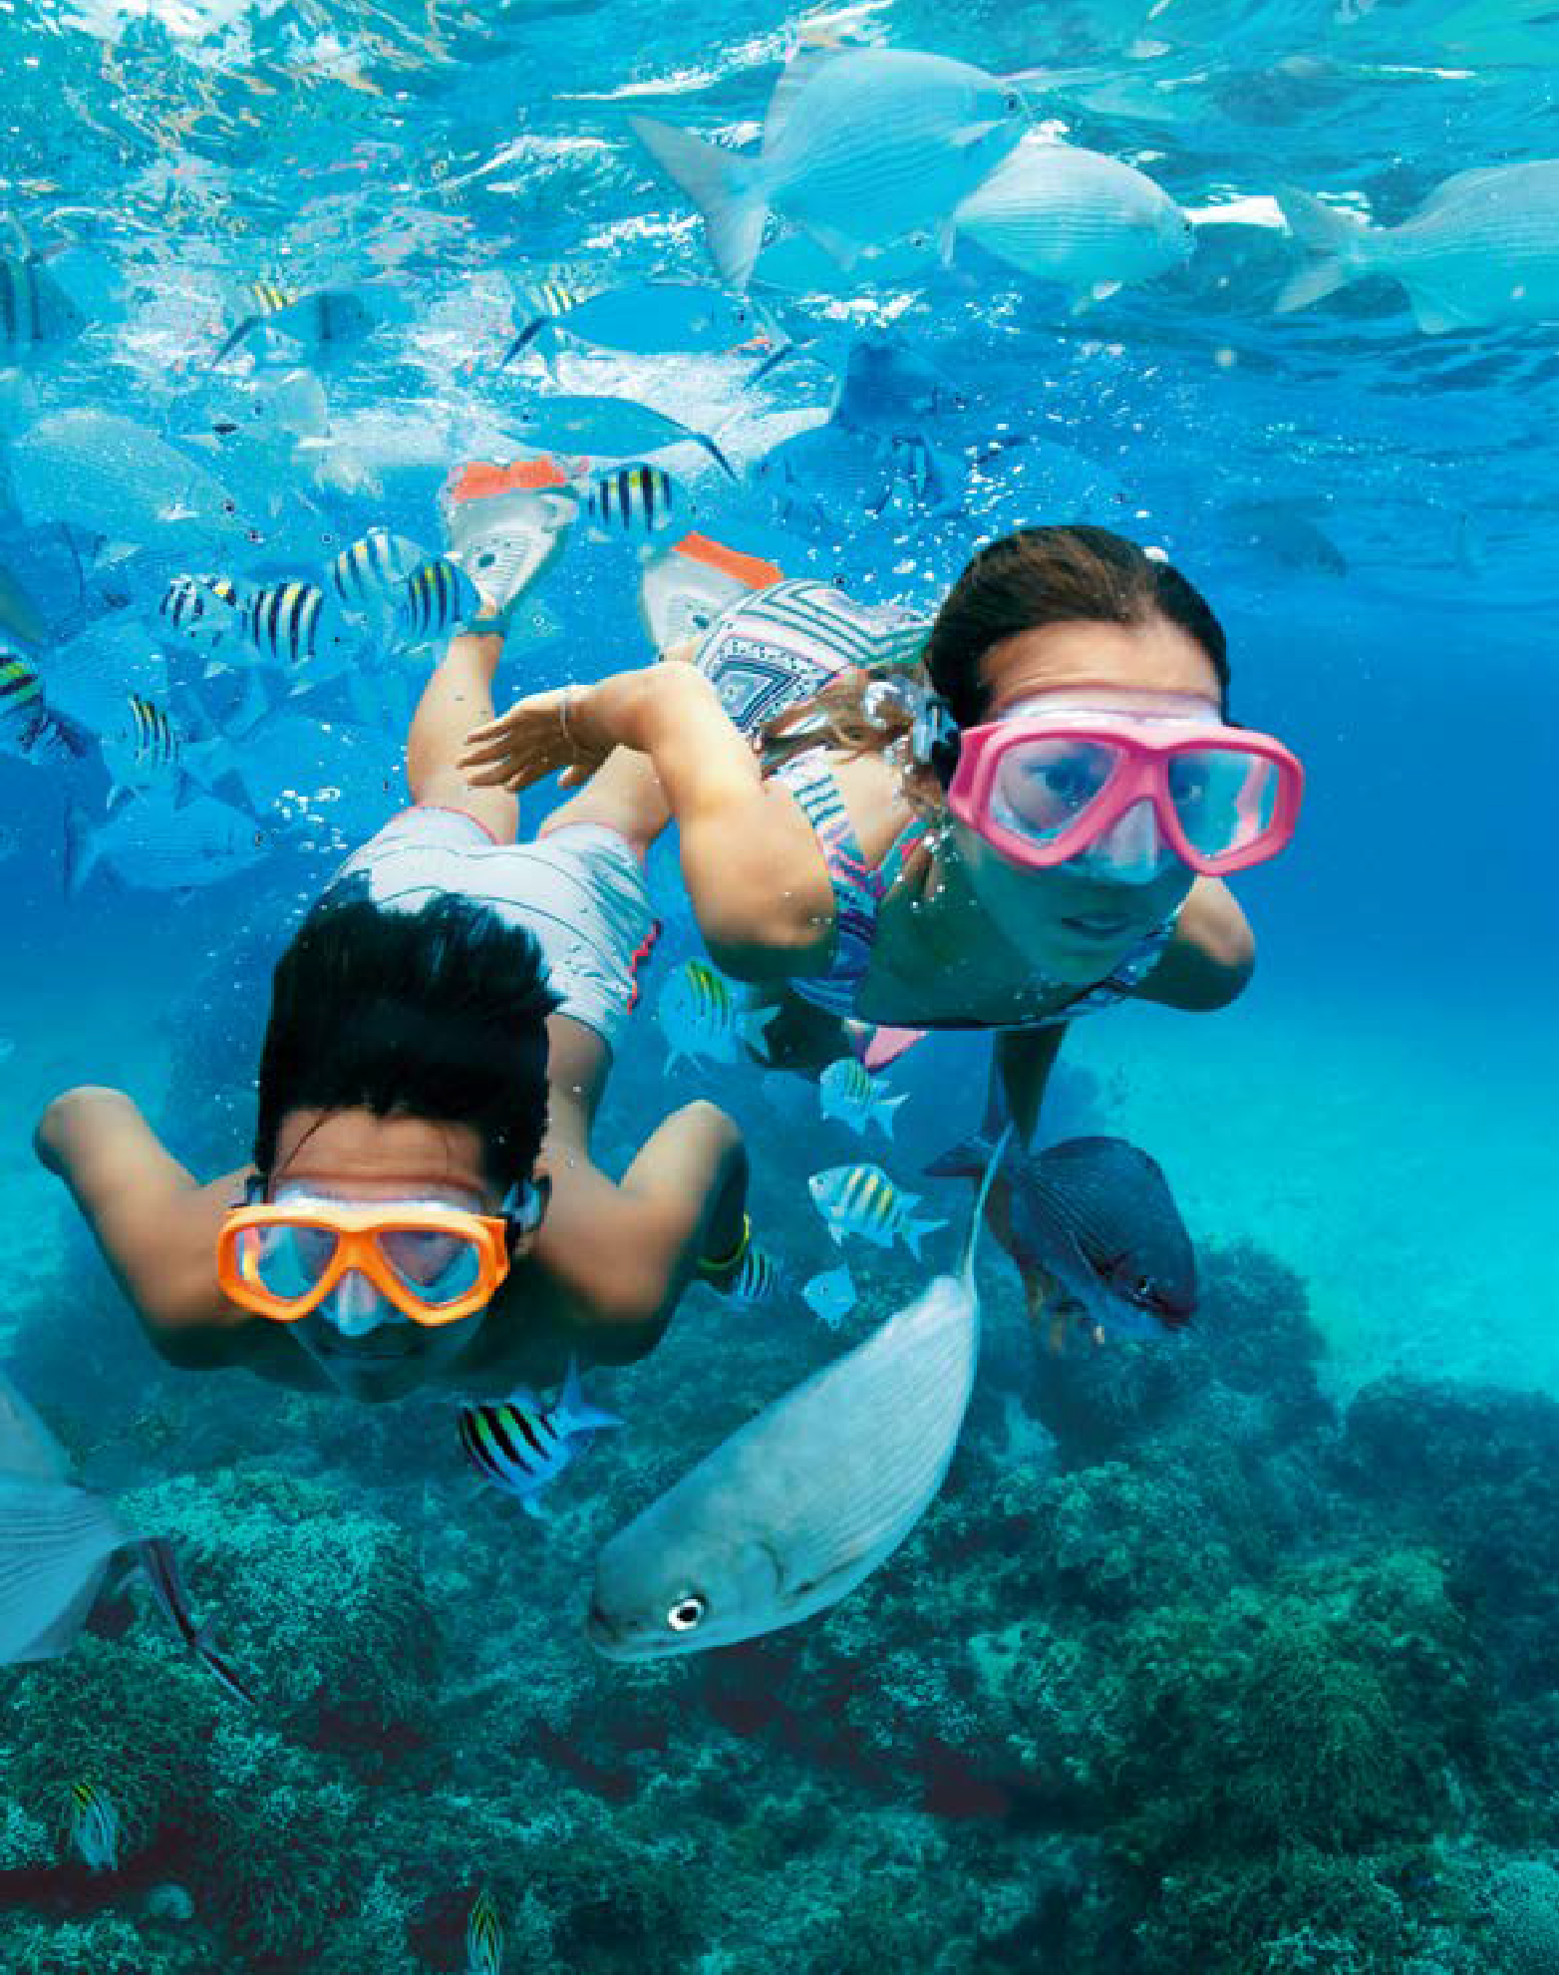
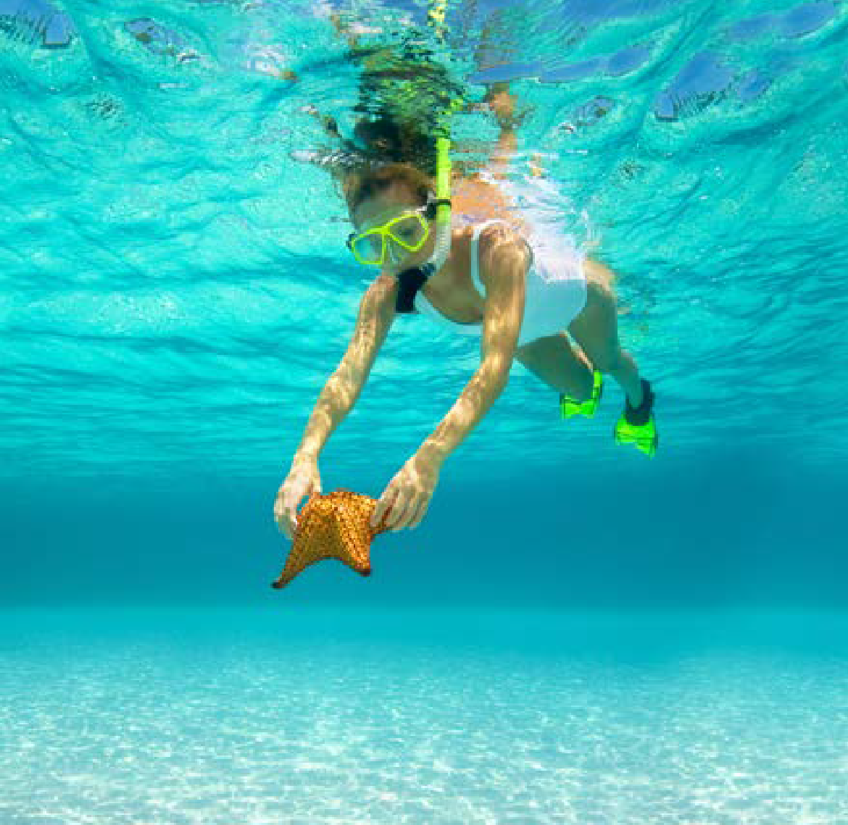
Cozumel, Mexico | Asset ID 38288
N o . 3 C AMP AIGN ELEMENTS >> PHO T OGRAPHY
WILDLIFE IMAGER Y
Choose imagery that shows people encountering wildlife
in their natural habitat, in an unobtrusive way. Never show them disturbing the animals.
DO NOT USE images that show captive wildlife or direct contact with wildlife in brand marketing materials.

Slide 42
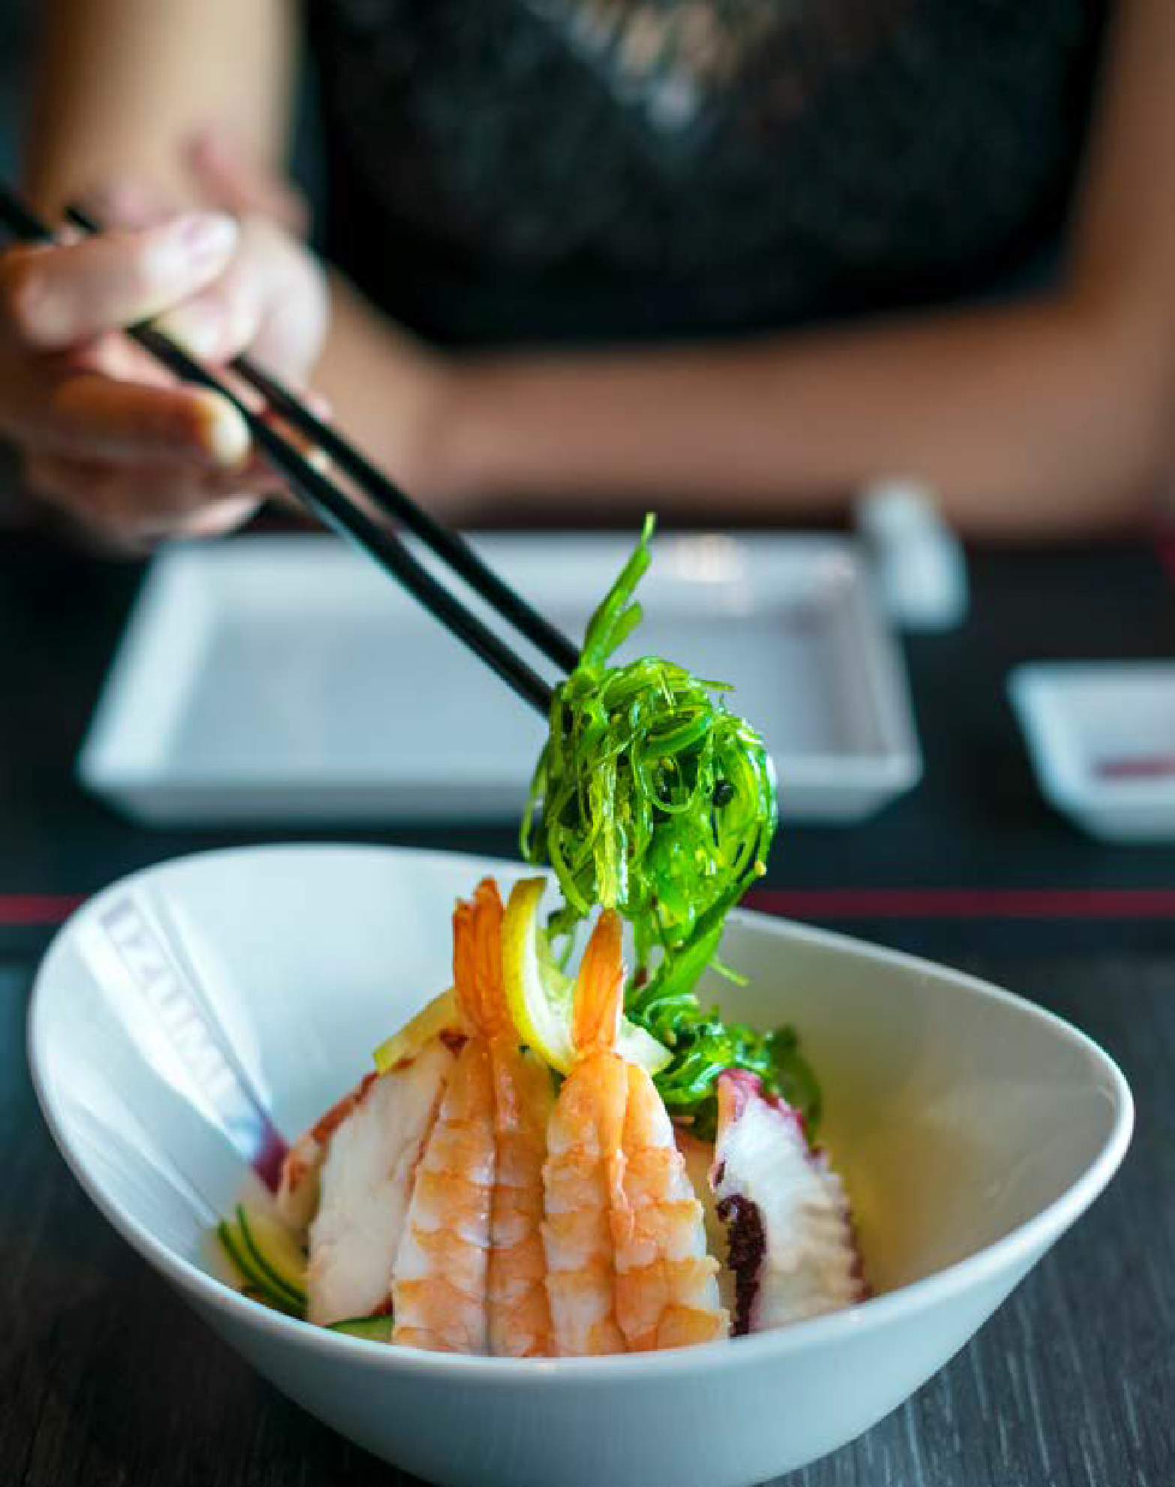
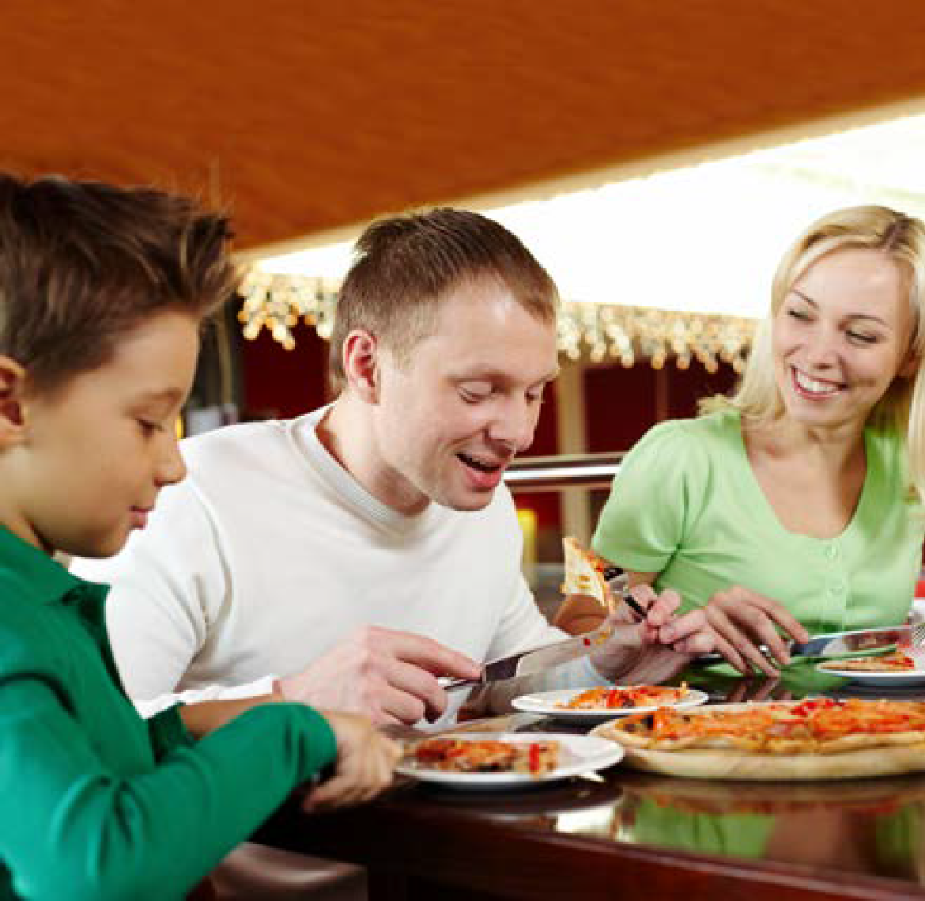
Citrus Seafood Salad — Izumi Japanese Cuisine | Asset ID 36601
N o . 3 C AMP AIGN ELEMENTS >> PHO T OGRAPHY
FOOD IMAGER Y
The approach to food photography should be editorial
in style. While a human element is fine, focus on the food, not the diners.
DO NOT USE staged pictures of people eating — palate-whetting food shots are more enticing.

Slide 43
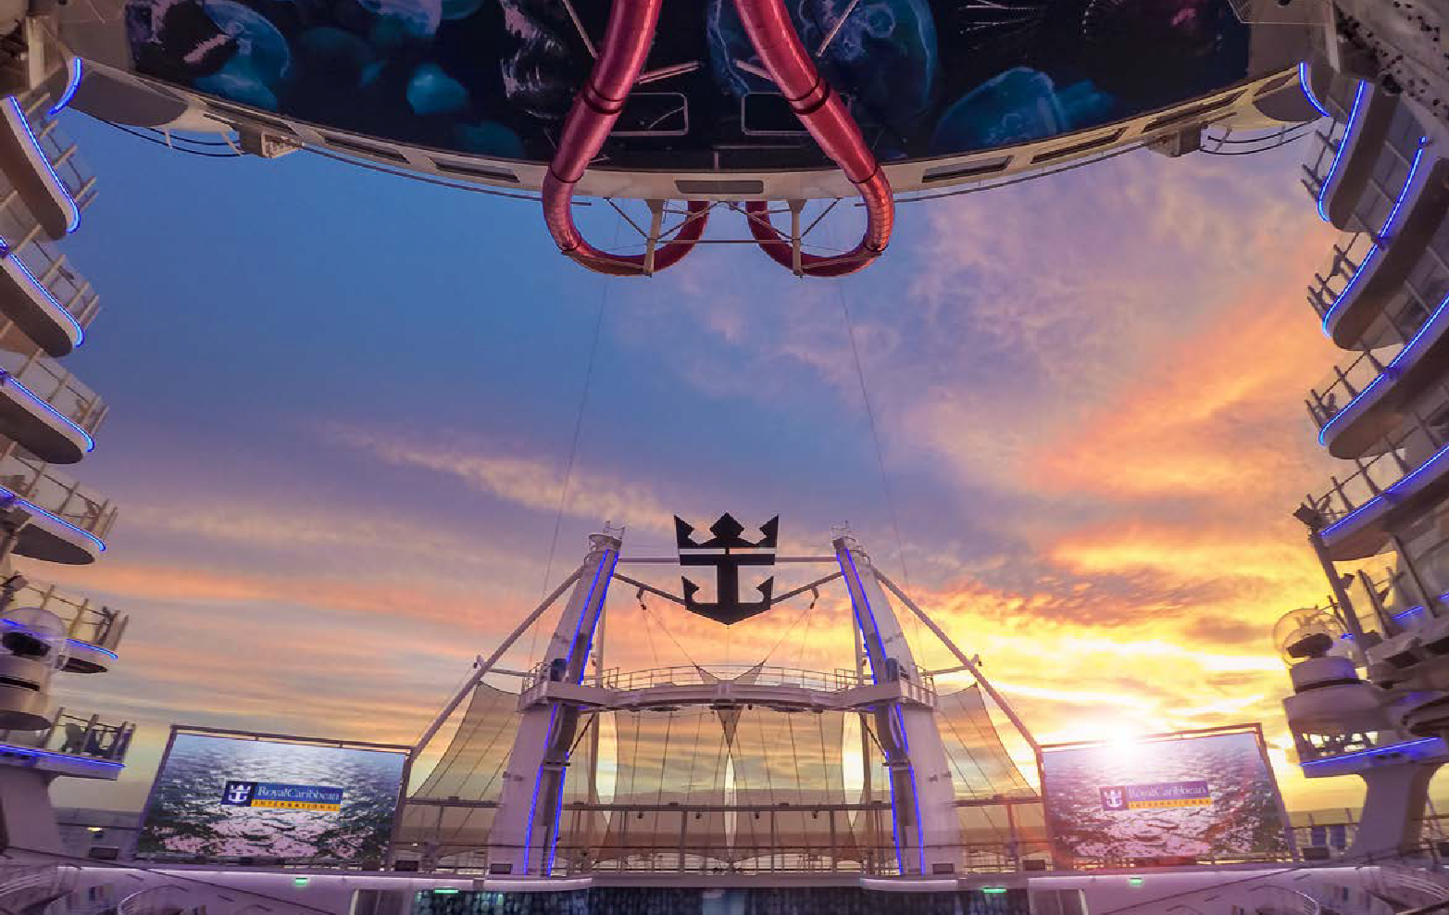
AquaTheater — Harmony of the Seas® | Asset ID 32154
N o . 3
C AMP AIGN ELEMENTS >> CORPORATE GUIDELINES
C A M P A I G N E L E M E N T S
C O R P O R A T E G U I D E L I N E S

Slide 44
O U R B R A N D N A M E
N o . 3
C AMP AIGN ELEMENTS >> CORPORATE GUIDELINES >> BRAND NAME
Name Usage
Never abbreviate or use initials. It’s not Royal, RC or RCI — it’s Royal Caribbean®. Always use the proper name.
Use initial caps.
Never use the brand name in a possessive form.
Include registration mark at either first mention, or most prominent.
Both words should always appear on the same line, with no hyphens.
Royal Caribbean Cruises Ltd. is the name of our
corporation. It should never be abbreviated, and does not use a trademark symbol.
Royal Caribbean International is our
company name, as you can see in our logo mark.
But in marketing and advertising, we use the brand name the average consumer knows —
Royal Caribbean®

Slide 45
H O W T O A P P L Y T R A D E M A R K S
N o . 3
C AMP AIGN ELEMENTS >> CORPORATE GUIDELINES >> TRADEMARK S
Headlines/Display Copy
Do not add trademarks to headlines or display copy (you can include it in terms & conditions instead).
Body Copy
Names should always appear with the mark the first time you mention it in body copy on every page of a communication.
Onboard Materials/Merchandise
There is no need for Royal Caribbean trademarks of any kind when creating onboard materials or merchandise.
Legibility
When creating large-scale pieces, print pieces with several
registered or service marked properties, digital pieces or other work where legibility is a concern, you also have the option of running the mention in the terms & conditions.
Royal Caribbean holds trademarks for all sorts of logos, taglines and amenity names —
too many to list here, in fact.
FOR CURRENT TRADEMARK S IN USE B Y R O YAL C ARIBBEAN, VISIT
WriteItRoyal.com

Slide 46





N o . 3
C AMP AIGN ELEMENTS >> CORPORATE GUIDELINES >> CORPORATE L OGOS
ALWAYS USE THE LOGO AS PROVIDED.
DO NOT A LTER, DISTORT OR ANGLE THE LOGO IN ANY WAY.
C O R P O R A T E L O G O
Download all logos at RCCLLibrary.com
The logo must appear on the first and most prominent occurrence of all communications, as well as back covers of printed materials.
LOGO SIZES
Please treat our logo with respect. Don’t crowd it with other elements. And don’t make it so small that it requires a magnifying glass to read it. Our logo should have presence within the piece.
MINIMUM CLEARANCE
Keep the “x” space around the logo free of visual distraction.
Our logo should appear at the bottom right of a piece whenever possible — think of it as our sign-off.
x = height of the yellow bar
When sharing the space with other logos, ours should always be equal in size
MINIMUM SIZE
Do not reproduce the logo smaller than the following size in order to maintain legibility.
= 3/8" (27px)
LOGO COLORS
ALWAYS use the three color logo, unless you only have one-color or grayscale printing available
LOGO VERSIONING
The versions below should really be your last resort. If you can’t print using multiple colors, only then should you default to one of the following options.
Asset ID 24305
LINE ART LOGO
ONLY use when production is limited to one color.
N AV Y BL UE
C 100 R 6
M 90 G 21
Y 0 B 86
K 55
PMS 281
HTML 061556
R O YA L BL UE
C 91 R 0
M 51 G 115
Y 0 B 187
K 0
PMS 2727
HTML 0073BB
R O YA L G O L D
C 0 R 254
M 28 G 189
Y 100 B 17
K 0
PMS 1235
HTML FEBD11
BACKGROUND USE
DO NOT use the three brand colors or similar colors for background.
When placed on a photograph, make sure there is sufficient contrast.
Asset ID 24308
GRAYSCALE LOGO
ONLY available for use in grayscale or black and white printing.
Asset ID 24307

Slide 47










N o . 3
C AMP AIGN ELEMENTS >> CORPORATE GUIDELINES >> CORPORATE L OGOS
ALWAYS USE THE LOGO AS PROVIDED.
DO NOT A LTER, DISTORT OR ANGLE THE LOGO IN ANY WAY.
C O R P O R A T E L O G O
It’s time to have a heart to heart. We’ve seen some pretty weird things
happening to our corporate logo, and we need to set the record straight.
LOGO COLORS
NEVER change the colors of the logo.
Changing our logo in any way implies we don’t take our brand seriously and makes it difficult to build recognition. As champions of our brand,
we look to you to protect our corporate logo.
LOGO DESIGN
NEVER remove or rearrange parts of the logo.
LOGO OUTLINE
NEVER add a stroke or outline to the logo.
LOGO VISIBILITY
NEVER obscure, cover or hide any part of the logo.
LOGO BACKGROUND
NEVER use one of the three brand colors or similar color values as a logo background. Make sure there is sufficient contrast so the logo stands out.
LOGO ROTATION
NEVER rotate or angle the logo. The bottom of the logo should always run straight along the x-axis.
LOGO RESPECT
NEVER use the logo in a location where it might be walked on,
driven on or worn with time.

Slide 48


N o . 3
C AMP AIGN ELEMENTS >> CORPORATE GUIDELINES >> CR O WN AND ANCHOR
ALWAYS USE THE LOGO AS PROVIDED.
DO NOT A LTER, DISTORT OR ANGLE THE LOGO IN ANY WAY.
C R O W N A N D A N C H O R L O G O
Asset ID for All Logos 42860
Download all logos at RCCLLibrary.com
The Crown and Anchor must always be used alongside the corporate logo, except in very specific circumstances
LOGO SIZES
MINIMUM CLEARANCE
Keep the “x” space around the Crown and Anchor free of visual distraction.
One exception is on merchandise, where the symbol can be allowed to stand alone — however, the Compass is the preferred option when being used in isolation.
x = height of top half of crown
Another is when creating onboard materials you also have the option to use the Crown and Anchor in place of the corporate logo
Never stack the Crown and Anchor with the corporate logo, or allow the symbol to overshadow the corporate logo
x = space between
Crown & Anchor
and box boundary
LOGO
VERSIONING
MINIMUM SIZE
Do not reproduce the logo smaller than the following size in order to
maintain recognizability of the mark.
= 0.275” (20px)
= 0.417” (30px)
Asset ID 24314
Asset ID 42859
INSIDE THE BOX
The Crown and Anchor inside the navy square is typically used for onboard collateral.
WITHOUT THE BOX
The Crown and Anchor can be used outside of the box. Typically this version is
reserved for apparel and merchandise.

Slide 49







N o . 3
C AMP AIGN ELEMENTS >> CORPORATE GUIDELINES >> CR O WN AND ANCHOR
ALWAYS USE THE LOGO AS PROVIDED.
DO NOT A LTER, DISTORT OR ANGLE THE LOGO IN ANY WAY.
C R O W N A N D A N C H O R L O G O
Download all logos at RCCLLibrary.com
LOGO DESIGN
NEVER remove or rearrange parts of the logo. NEVER skew, crop or otherwise
compromise the integrity of the mark.
The Crown and Anchor logo is the most iconic singular representation of our company and brand. With nearly 50 years equity behind it, the
Crown and Anchor should be treated with due respect and left to stand on its own without alteration. Basically, don’t mess with it. Ever.
LOGO ADDITIONS
NEVER add elements to the Crown and Anchor, like seasonal items or other embellishments, however cute your hat might look.
BORROWING THE LOGO
NEVER create logos or lockups that feature or use parts of the Crown and Anchor.
LOGO COLOR
The Crown and Anchor should only appear in white, navy blue or black (in one color printing).
NEVER change the logo color.
In select applications, such as on premium items, it may appear in gold or silver foil.
LOGO RESPECT
NEVER use the logo in a location where it might be walked on, driven on or worn with time.
LOGO ROTATION
NEVER rotate or angle the logo.
APPAREL AND MERCHANDISE
While there is some flexibility in how the Crown and Anchor can be used on apparel and merchandise, any specific altered uses that
contradict the provided guidelines must be reviewed by the brand team.
Contact Ana Rebbapragada (ARebbapragada@rccl.com) for approval.
LOGO OUTLINE
NEVER add a stroke or outline to the logo.

Slide 50

N o . 3
C AMP AIGN ELEMENTS >> CORPORATE GUIDELINES >> THE COMP A SS
ALWAYS USE THE LOGO AS PROVIDED.
DO NOT A LTER, DISTORT OR ANGLE THE LOGO IN ANY WAY.
T H E C O M P A s s L O G O
Download all logos at RCCLLibrary.com
The Compass logo offers us another great branding element. It embraces the spirit of our Come Seek campaign, combining our
iconic Crown & Anchor with a symbolic representation of our identity as a travel company, the compass outline.
LOGO SIZES
We get it. Things are cuter smaller. We’re good with cute and small, but not miniscule. So make sure you adhere to the size requirements below.
MINIMUM CLEARANCE
Keep the “x” space around the Crown and Anchor free of visual distraction.
x = height of crown
The Compass should never replace our corporate logo or be used without it, except on merchandise and apparel
MINIMUM SIZE
Do not reproduce the compass smaller than the following size in order to
maintain recognizability of the mark.
= 0.55" ( XXpx)
Don’t place the Compass and corporate logo side by side in layout
Check out pages 57 and 59-62 for how to use the compass in layout.
LOGO USAGE
The Compass is a branding tool that can help create hierarchy in
content heavy mid to lower funnel work or serve as a strong branding element in upper funnel creative and merchandise and apparel.
LOGO VERSIONING
Asset ID 45047
WHITE VERSION
The white version of the Compass is our primary logo version. It can be used over color and photographic backgrounds.
AS A CONTENT DIVIDER
The Compass can be used as a content
divider to create hierarchy when framed with
two horizontal 1 pt dotted lines
Please note: The dotted lines should always match the color of the compass.
=
Asset ID 45046 Asset ID 45045
ALTERNATE VERSIONS
On white backgrounds, a gray or navy blue compass can be used. Foil finishes may also be used. The
compass should NEVER be used in black.
MERCHANDISE AND APPAREL
When using the Compass, merchandise and apparel is the only instance where the corporate logo is not required to be present. There is also more flexibility in printing and application techniques, whether it be stitched or adorned using other finishes.

Slide 51

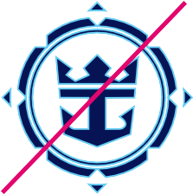
N o . 3
C AMP AIGN ELEMENTS >> CORPORATE GUIDELINES >> CR O WN AND ANCHOR
ALWAYS USE THE LOGO AS PROVIDED.
DO NOT A LTER, DISTORT OR ANGLE THE LOGO IN ANY WAY.
T H E C O M P A s s L O G O
Download all logos at RCCLLibrary.com
LOGO DESIGN
NEVER remove or rearrange parts of the logo. NEVER skew, crop or otherwise
compromise the integrity of the mark.
We know the Compass looks cool — we’re fans too. But it’s important to follow a few guidelines for consistent use so we don’t dilute its impact as a branding element.
LOGO RESPECT
NEVER use the Compass in a location where it might be walked on, driven on or worn with time.
LOGO COLOR
The Compass should always be one color.
Primary usage is white, but for legibility purposes, it may be used as gray or navy.
NEVER change the logo color beyond these variations or use the compass in black.
In select applications, such as on premium items, it may appear in gold or silver foil.
LOGO PAIRING
NEVER place the Compass and
corporate logo side by side in layout.
LOGO ROTATION
NEVER rotate or angle the logo.
APPAREL AND MERCHANDISE
While there is some flexibility in how the Compass can be
used on apparel and merchandise, any specific altered uses that
contradict the provided guidelines must be reviewed by the brand team.
Contact Ana Rebbapragada (ARebbapragada@rccl.com) for approval.
LOGO OUTLINE
NEVER add a stroke or outline to the logo.

Slide 52













A C C O L A D E S
N o . 3
C AMP AIGN ELEMENTS >> CORPORATE GUIDELINES >> A CCOLADES
Download all accolades at RCCLLibrary.com
Royal Caribbean is an innovator and an industry leader — and we have
the awards to prove it. Accolades allow us to set ourselves apart from the competition by graphically showcasing the recognition we’ve earned.
Take a look at pages 55-65 for examples of how to use accolades in layout.
OVERALL
CARIBBEAN
OVERALL + CARIBBEAN
Asset ID 42453
Asset ID 42448
Asset ID 42446

Slide 53
R O Y AL C ARIBBEAN ®
COME SEEK BRAND GUIDELINES
S E C T I O N N o . 4
C A M P A I G N D E S I G N

Slide 54
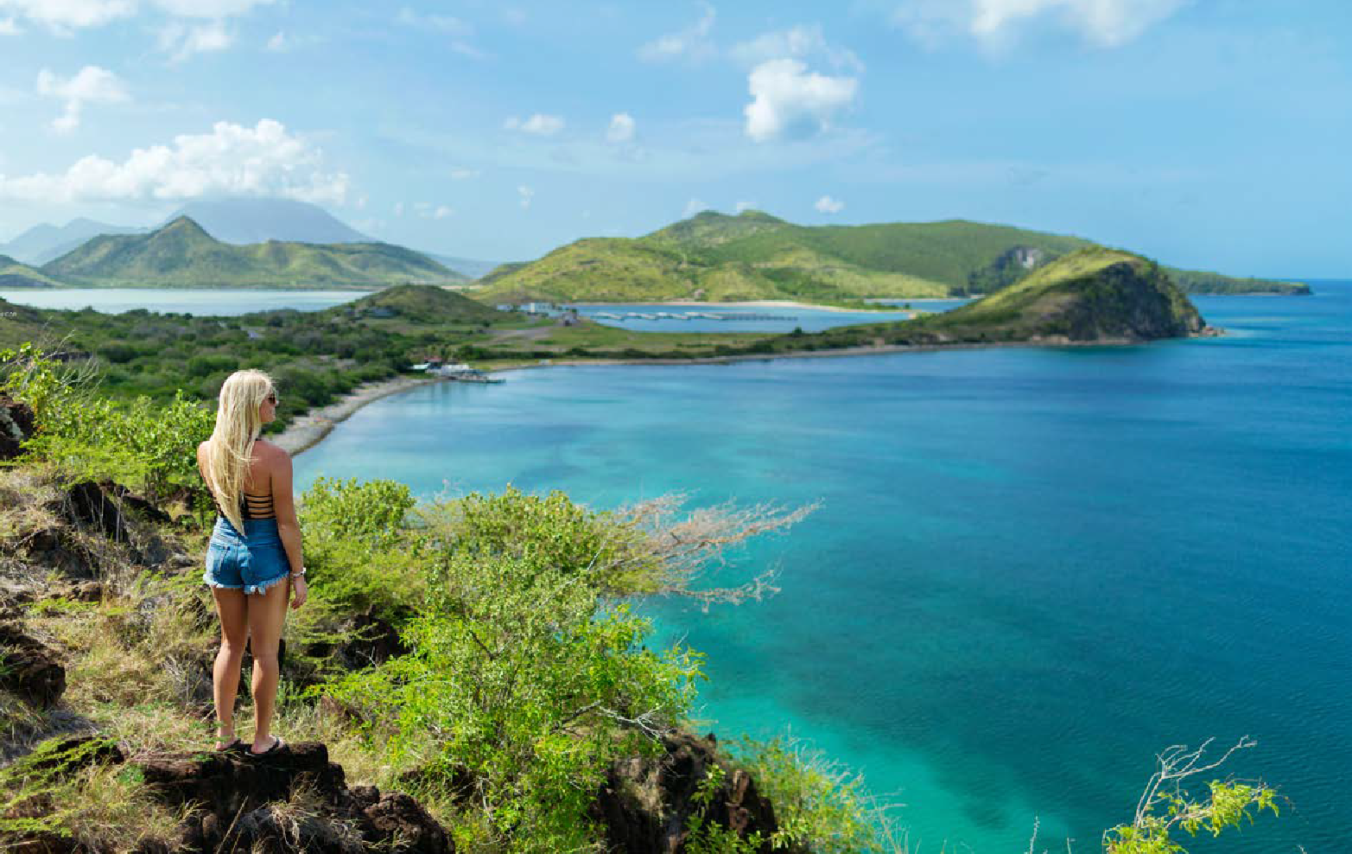
Friars Bay, St. Kitts | Asset ID 32501
N o . 4
C AMP AIGN DESIGN >> PRINT
C A M P A I G N D E S I G N
P R I N T S A M P L E S

Slide 55
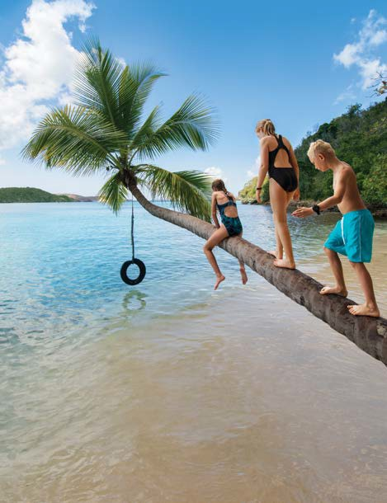



N o . 4
C AMP AIGN DESIGN >> PRINT >> FULL P A GE ADS
Gibney Beach, St. John | Asset ID 34681
F U L L P A G E A D S
Whenever possible, full page ads should feature a full image. Just be sure cropping accounts for copy placement, headlines and logos.
St. John, U.S. Virgin Islands
T H I S I S
A D V E N T U R E W I T H I N R E A C H
Captions
On a full frame image, the caption should be centered at the top of the page.
Headlines
When placing headlines, overlapping people is okay, but don’t cover their eyes.
Body Copy
If body copy is not legible over an image make every effort to retouch the image. Otherwise, refer to Colorblock ad layouts on pages 57-58.
Accolades & Logos
Accolades should be applicable to the publication and audience.
Try to keep our corporate logo in the bottom right corner, like a sign-off.
This is not a cruise. This is a tropic trekking journey onboard one of the world’s most incredible ships — Allure of the Seas®. Gear up for full-throttle ATV thrills in Cozumel. Tube the cool waters of Jamaica’s Martha Brae River. And soar down the world’s longest overwater zip line at our private destination, Labadee®. This is not the Caribbean — this is the Royal Caribbean®.
Allure of the Seas®
7 NIGHT WESTERN CARIBBEAN
Sailing from Fort Lauderdale, Florida
Product Callout
Here’s the proper order: ship name in the lead, followed by itinerary and departure port. Ports of call and pricing can also be added following
that, as needed.
For more information, contact your Ensemble travel advisor.
Itineraries are subject to change without notice. Features vary by ship. ©2019 Royal Caribbean Cruises Ltd. Ships’ Registry: The Bahamas.
Trim Size: 8.375” x 10.75”
55

Slide 56
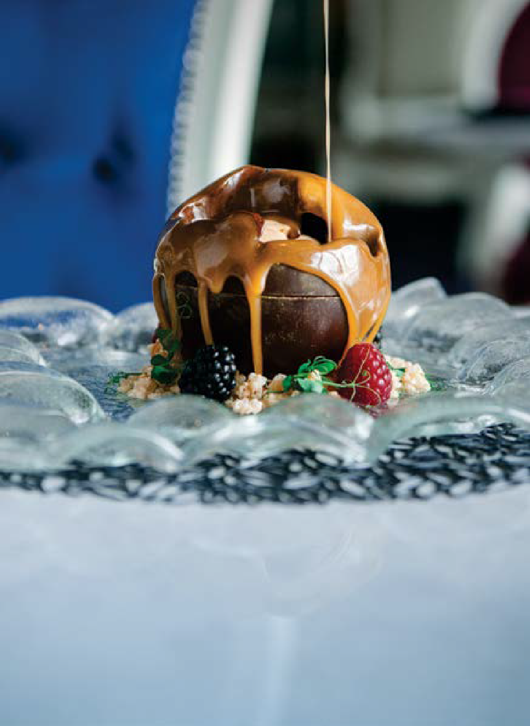
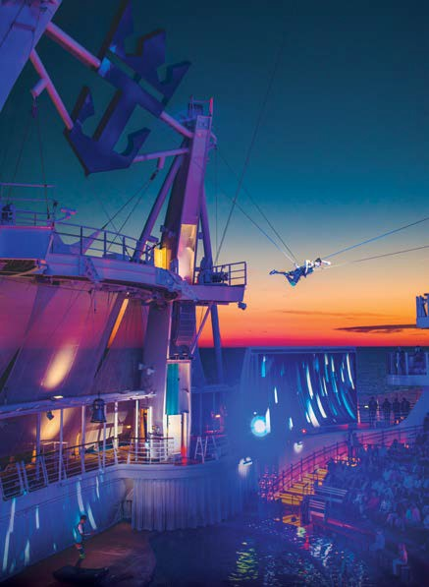






N o . 4 C AMP AIGN DESIGN >> PRINT >> FULL P A GE ADS
The World Dessert — Wonderland Imaginative Cuisine | Asset ID 38358
AquaTheater — Harmony of the Seas® | Asset ID 38891
The World Dessert — Won derland Imaginative Cuisine
AquaTheater — Only on Royal Caribbean®
PHOTO CAPTIONS
If your caption is getting complicated
feel free to use
A N A D V E N T U R E
an em dash.
O F E P I C U R E A N
S U S P E N D Y O U R R E A L I T Y
P R O P O R T I O N S
This is not a cruise. This an island-hopping expedition where the journey is just as thrilling as the destination — onboard the world’s most incredible ships, Oasis®, Allure® and Harmony of the Seas®.
Plus the new Symphony of the Seas®. It’s excitement drenched slides and rides. Family fun by
the gallon. Shows that transcend the stage. And gourmet globetrotting from Italy to Wonderland. Only on Royal Caribbean®.
This is not a cruise. This is culinary course charting at sea. Dine like the stars at Jamie’s Italian
by celebrity chef Jamie Oliver. Savor just-shucked oysters at Hooked SeafoodSM. Watch as food
becomes art at Wonderland Imaginative Cuisine. Sip reds and whites over ocean blues at Vintages
COME SEEK
TWO LINE CT
If your CTA is a
longer, you can br it into two lines
A
bit eak
.
wine bar. Go crazy over casual Mexican at El Loco FreshSM or indulge in an exclusive five course
You can use the Come Seek
feast at Chef’s Table. The flavors — and adventures — are limitless on Royal Caribbean®.
lockup as a sign-off to the
Contact your Virtuoso® Travel Advisor
Learn more at Ro
yalCaribbean.com
body — just be sure the copy
to learn about exclusive benefits.
doesn’t also close with it.
Features vary by ship. Come Seek is a registered trademark of Royal Caribbean. ©2019 Royal Caribbean Cruises Ltd. Ships’ Registry: The Bahamas.
Features vary by ship. Come Seek is a registered trademark of Royal Caribbean. ©2019 Royal Caribbean Cruises Ltd. Ships’ Registry: The Bahamas.
Trim Size: 8” x 10.75”
Trim Size: 8” x 10.75”
56

Slide 57
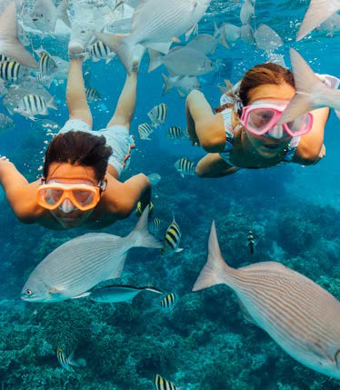








N o . 4
C AMP AIGN DESIGN >> PRINT >> COL ORBL OCK ADS
C O L O R B L O C K A D S
Colorblock ads offer a clean
solution for various challenges,
including limited ad size, unusual dimensions, or photography that can’t accommodate a full image
layout or retouching is not an option to make copy legible.
Cozumel, Mexico | Asset ID 38288
T H I S I S
U N C H A R T E D A D V E N T U R E
*
Don’t send your clients on a vacation.
Send them on a savings scoring, undersea exploring expedition the whole family can dive into. Only on Royal Caribbean®.
Learn more at
Colorblock Placement
On vertical ads, the colorblock is always below the hero. On horizontal ads, it goes to the right of the hero.
LoyalToYouAlways.com
Photo Captions
On colorblock ads, the caption should be placed in the lower left corner of the image.
*Features vary by ship. All itineraries are subject to change without notice.
©2019 Royal Caribbean Cruises Ltd. Ships’ registry: The Bahamas.
Cozumel, Mexico
Trim Size: 7.625” x 4.875”

Slide 58
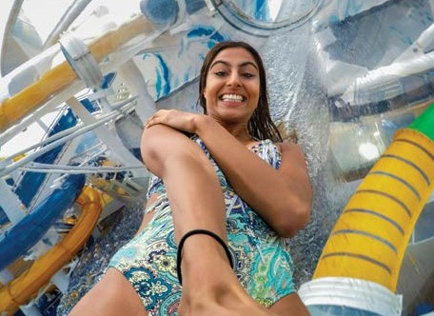
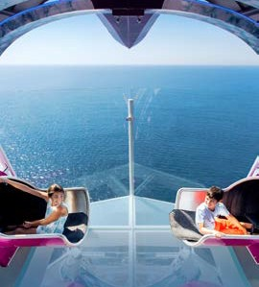






N o . 4
C AMP AIGN DESIGN >> PRINT >>
COL ORBL OCK ADS
The Perfect StormSM — Harmony of the Seas® | Asset ID 32152
P L U N G E I N T O A D V E N T U R E
Ultimate AbyssSM — Harmony of the Seas® | Asset ID 27835
This is not a cruise. This is the Caribbean adventure of a lifetime onboard the world’s most incredible ships. It’s
The Perfect StormSM waterslide trio, family fun by the gallon at Splashaway BaySM, high-flying thrills at the AquaTheater and dining that takes your clients from Italy to Wonderland. This is not the Caribbean — this is the Royal Caribbean®.
Y E A R - R OU N D C A R IB B E A N S A IL ING S
Harmony of the Seas®
Departing from Fort Lauderdale, FL
Allure of the Seas®
Departing from Fort Lauderdale, FL
Contact your local AAA office
for exclusive promotions and benefits.
AAA.com/ Travel or 1-888-AAA-OHIO
T H I S I S N O T
Y O U R T Y P I C A L
S I B L I N G R I V A L R Y
SUBHEAD
You have the freedom
to include a subhead when you need to expand on the headline or make the ad’s
Perfect StormSM waterslides
subject matter more scannable.
N E W T H R IL L S S A IL IN G F R OM C A P E L IB E R T Y
This is not a cruise. This is trading sea days for see more days on the newest adventure sailing from the Big Apple — Adventure of the Seas® . Race through The Perfect StormSM waterslides. Hang ten high above the waves on the FlowRider® surf simulator. And treat your taste buds to sushi, dry aged steaks and
Italian trattoria, before salsa dancing at Boleros. This is not the Caribbean — this is the Royal Caribbean®.
The Ultimate AbyssSM — Harmony of the Seas
Features vary by ship. All itineraries are subject to change without notice. ©2019 Royal Caribbean Cruises Ltd. Ships’ registry: The Bahamas.
Trim Size: 9” x 5.25”
Adventure of the Seas®
7 NIGHT BAHAMAS CRUISE
Sailing from Cape Liberty, New Jersey • May – August 2018
Call us at 1 (866) 910-9778 or visit LibertyTravel.com/ Royal to explore the unique experiences we have to offer.
The pricing and promotions listed on this advertisement are being included by the travel agency and are not the responsibility of Royal Caribbean International or its parent company or aﬃliates. Contact your travel agency for more information. Features vary by ship. All itineraries are subject to change without notice. ©2019 Royal Caribbean Cruises Ltd. Ships’ registry: The Bahamas.
Trim Size: 8.125” x 10.875”

Slide 59
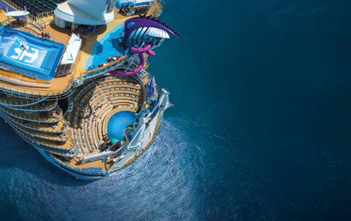



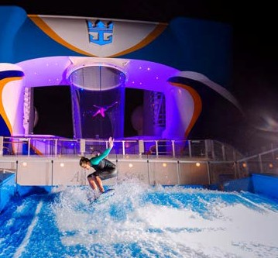






N o . 4
C AMP AIGN DESIGN >> PRINT >> SPREAD ADS
Harmony of the Seas® | Asset ID 28669
S P R E A D A D S
Spread ads offer greater visual impact through two
consecutive pages of real estate within a publication, as well as space to tell a bigger story through more
copy, or inset images, where appropriate.
T H I S I S T H E
N E W F O U R F R O N T O F A D V E N T U R E
Oasis of the Seas® • Allure of the Seas®
Harmony of the Seas® • Symphony of the Seas®
This is not a cruise. This is four of the world’s best ships, three convenient Florida homeports and countless Oasis Class favorites. Take the plunge down the tallest slide at sea — Ultimate AbyssSM. Catch a wave right on deck on the FlowRider®, and catch high-flying entertainment at AquaTheater. Explore seven distinct neighborhoods and discover dining that takes you from Italy to Wonderland. Only on Royal Caribbean®
Contact your travel advisor to plan your next vacation.
Layout
When designing a spread ad, you can use either a full frame image across both
pages, or a colorblock on the right third of the layout. In either case, body copy and additional copy elements, such as CTA, sailing info, etc. go on the right.
Harmony of the Seas ®
*Features vary by ship. ©2019 Royal Caribbean Cruises Ltd. Ships’ registry: The Bahamas.
Headline
Headline placement depends on the layout. On the colorblock layout, it should always be placed on the left page. On full bleed layouts it can be arranged on either the left side, or right side above body copy — go with what works better for the image.
Y O U ’ R E A
H I G H F L Y I N G T I D E T A M E R
RipCord® by iFLY®
North Star®
Bionic Bar®
This is not a cruise. This is how you make vacation days legendary. Defy gravity without leaving deck on
RipCord® by iFLY®. Hang ten on the FlowRider® surf simulator.
Watch a robot mix cocktails at Bionic Bar®, and discover ahh-inspiring cuisine at Wonderland. All while island hopping
from San Juan to St. Thomas on a ship that’s a smart island all on its own. Come Seek the Royal Caribbean®.
Anthem of the Seas®
9 NIGHT CANADA AND NEW ENGLAND
12 NIGHT SOUTHERN CARIBBEAN
Sailing year-round from Cape Liberty, New Jersey
Learn more at RoyalCaribbean.com
Features vary by ship. Come Seek is a registered trademark of Royal Caribbean.
©2019 Royal Caribbean Cruises Ltd. Ships’ Registry: The Bahamas.
Borders
If using a full frame image, a full border runs along the full perimeter of the ad. For the colorblock layout, use the quarter border under the colorblock only.
Inset Images
If you apply inset images, use the colorblock layout and arrange the images over the block to avoid cluttering the hero.
FlowRider® and RipCord® by iFLY®
FlowRider® Surf Simulator and RipCord® by iFLY® | Asset ID 38889
59

Slide 60



N o . 4
C AMP AIGN DESIGN >> PRINT >>
SPREAD ADS
Harmony of the Seas® | Asset ID 28669
T H I S I S T H E
N E W F O U R F R O N T
O F A D V E N T U R E
Oasis of the Seas® • Allure of the Seas®
Harmony of the Seas® • Symphony of the Seas®
This is not a cruise. This is four of the world’s best ships, three convenient Florida homeports and countless Oasis Class favorites. Take the plunge down the tallest slide at sea — Ultimate AbyssSM. Catch a wave right on deck on the FlowRider®, and catch high-flying entertainment at AquaTheater. Explore seven distinct neighborhoods and discover dining that takes you from Italy to Wonderland. Only on Royal Caribbean®
Contact your travel advisor to plan your next vacation.
Harmony of the Seas ®
*Features vary by ship. ©2019 Royal Caribbean Cruises Ltd. Ships’ registry: The Bahamas.
Trim Size: 17” x 10.875”

Slide 61
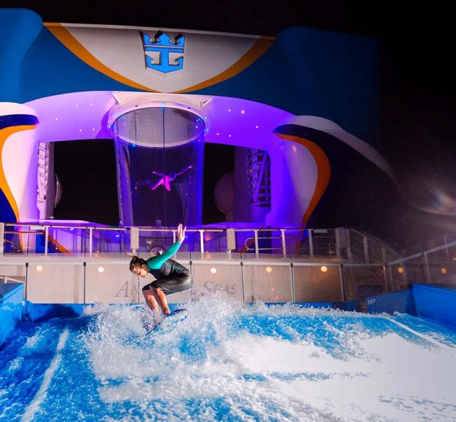
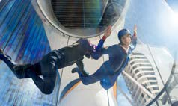




N o . 4
C AMP AIGN DESIGN >> PRINT >>
SPREAD ADS
FlowRider® Surf Simulator and RipCord® by iFLY® | Asset ID 38889
RipCord® by iFLY®
Asset ID 31640
Y O U ’ R E A
H I G H F L Y I N G T I D E T A M E R
RipCord® by iFLY®
LEFT:
North Star®
Asset ID 31642
RIGHT:
Bionic Bar®
Asset ID 10982
North Star®
Bionic Bar®
This is not a cruise. This is how you make vacation days legendary. Defy gravity without leaving deck on
RipCord® by iFLY®. Hang ten on the FlowRider® surf simulator.
Watch a robot mix cocktails at Bionic Bar®, and discover
ahh-inspiring cuisine at Wonderland. All while island hopping from San Juan to St. Thomas on a ship that’s a smart
island all on its own. Come Seek the Royal Caribbean®.
Anthem of the Seas®
9 NIGHT CANADA AND NEW ENGLAND
12 NIGHT SOUTHERN CARIBBEAN
Sailing year-round from Cape Liberty, New Jersey
Learn more at RoyalCaribbean.com
FlowRider® and RipCord® by iFLY®
Features vary by ship. Come Seek is a registered trademark of Royal Caribbean.
©2019 Royal Caribbean Cruises Ltd. Ships’ Registry: The Bahamas.
Trim Size: 8.375” x 10.75”

Slide 62
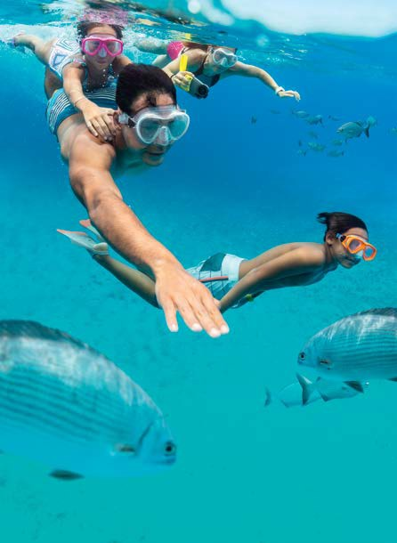




N o . 4
C AMP AIGN DESIGN >> PRINT >> P AR TNER C TAS
Perfect Day at CocoCay, Bahamas | Asset ID 38640
P A R T N E R C T A s
Frequently, we’ll advertise with a Co-Op
partner. This is how you execute a partner CTA using our brand’s preferred method.
Perfect Day at CocoCay, Bahamas
D E E P D I V E
I N T O A D V E N T U R E
CTA
CTA should drive to the travel partner as indicated by the requestor
Royal Caribbean Logo
The Royal Caribbean logo should be at the bottom right whenever possible
Partner Logos
Any partner logos or accolades should appear next to the Royal Caribbean logo, scaled to an equal size
This is not a cruise. This is family time redefined onboard the most spectacular ships at sea. Leave
no wave unturned on the FlowRider®. Conduct science experiments at the Adventure Ocean® youth program. And plunge down the tallest slide at sea, Ultimate AbyssSM. All between endless adventures onshore, everywhere from St. Kitts to St. Croix. Come Seek the Royal Caribbean®.
Contact Your Virtuoso® Travel Advisor
to learn about Virtuoso Exclusive Benefits.
Venues, activities and itineraries vary by ship. Contact your Virtuoso travel advisor for complete details. Perfect Day and Come Seek are registered trademarks of Royal Caribbean International. ©2019 Royal Caribbean Cruises Ltd. Ships’ registry: The Bahamas.
Trim Size: 8” x 10.75”
62

Slide 63

P A R T N E R V I S U A L S
N o . 4
C AMP AIGN DESIGN >> PRINT >> P AR TNER C TAS
In select instances, a Co-Op partner might want an expanded CTA to include visuals.
Though it’s not common practice, this is how we would do that while still maintaining the brand’s look and feel.
BRAND CREATIVE SHOULD OCCUPY 2/3 OF TOTAL VISUAL SPACE
Brand creative should always take up at least two thirds of the overall visual space
Partner messaging — including visuals, CTA and contact
information — can occupy up to one third of the real estate
PARTNER MESSAGING SHOULD OCCUPY NO MO RE THAN 1/3 TOTAL VISUAL SPACE
Partner visuals, such as headshots, should take up no more than one quarter of the allocated partner space
P AR TNER L OGO
Logos should be equal size.
The Royal Caribbean logo should not exceed 1/3 the width of the creative.
Visuals can occupy
up to 1/4 of partner space
=
63

Slide 64
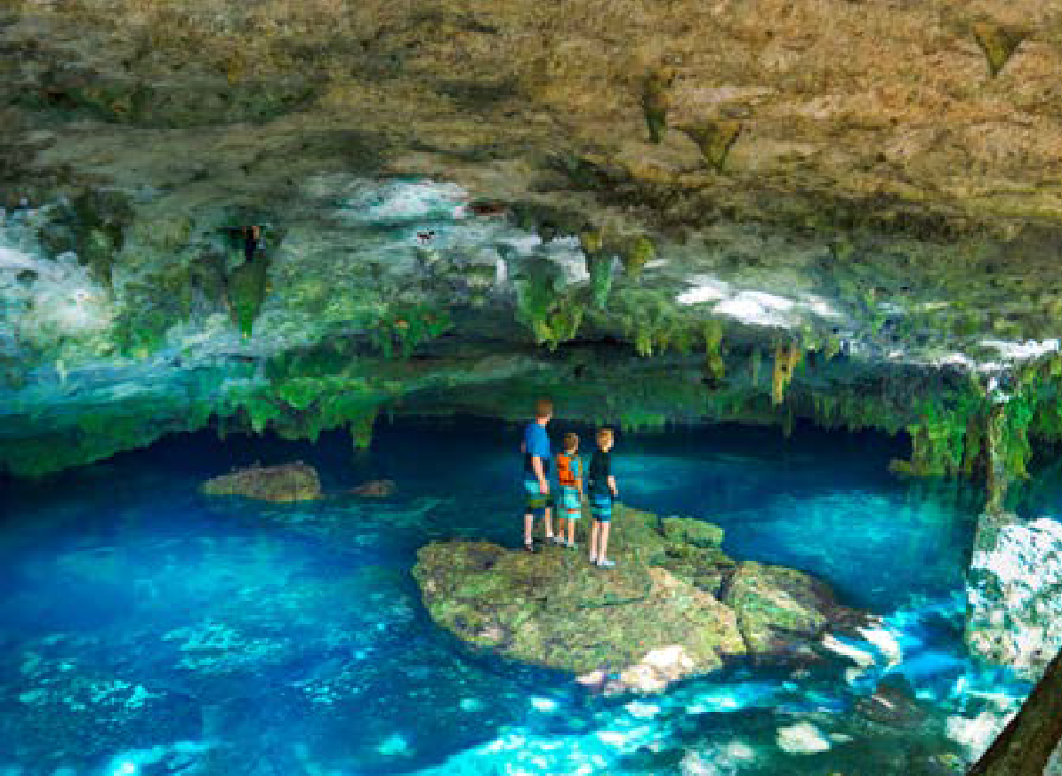





N o . 4
C AMP AIGN DESIGN >> PRINT >> F LYER S
Cozumel, Mexico | Asset ID 36519
T H I S I S
A D V E N T U R E O N E V E R Y L E V E L
Cozumel, Mexico
KIDS SAIL
This is not a cruise. This is an adventure amping journey far beyond the borders of ordinary. Go course charting through Cozumel’s cenotes. Or make friends with flamingos in Bonaire.
Team up for non-stop thrills on every incredible island with Royal Caribbean®. Ask your travel advisor for all the ways to save big on your next shore exploring expedition.
Book your next adventure today. Hurry, offer ends October 31 , 2019
ENTER AGENCY NAME HERE
Enter phone number and/or email
*Oﬀer terms and conditions go here. Features vary by ship. Come Seek is a registered trademark of Royal Caribbean. ©2019 Royal Caribbean Cruises Ltd. Ships registry: Bahamas.
F L Y E R S
Consumer-facing flyers offer travel partners a
tool that’s easy for them to customize and print.
Heroes
There’s a .25” white border around the hero area to allow travel partners to print on a standard 8.5 x 11” sheet.
Editable Fields
Editable fields allow travel partners to customize the flyer with their agency contact info, and should be placed to the lower left beneath the CTA.
Come Seek
This example shows how we use the grayscale version of the Come Seek
lockup to avoid competing with the offer lockup above. You could also use the navy option.
Trim Size: 8.5” x 11”
64

Slide 65



N o . 4
C AMP AIGN DESIGN >> PRINT >> POS TER S
Labadee®, Haiti | Asset ID 35254
Our private destination, Labadee®
P O S T E R S
Posters and panel designs offer an opportunity to create visually impactful pieces that
showcase strong imagery.
Hero
High level brand posters may feature the Come Seek lockup or a campaign headline centered over the hero image.
Additional Elements
Keep the look clean. Accompanying copy elements or logos — aside from our corporate logo and a possible partner logo — are a no-go.
Come Seek is a registered trademark of Royal Caribbean. ©2019 Royal Caribbean Cruises Ltd. Ships’ registry: The Bahamas.
Trim Size: 24” x 36”
65

Slide 66






N o . 4
C AMP AIGN DESIGN >> PRINT >>
POS TER S
FlowRider® Surf Simulator | Asset ID 36417
Up, Up and Away — Perfect Day at CocoCay, Bahamas | Asset ID 44879
FlowRider® Surf Simulator — Only on Royal Caribbean®
Up, Up and Away — Perfect Day at CocoCay, Bahamas
T H I S I S T O P D E C K
T I M E F O R
A N A L T I T U D E
T I D E T A M I N G
A D J U S T M E N T
CAMPAIGN HEADLINE
When introducing a campaign headline, the Come Seek lockup
can drop below as a sign-off above the corporate logo.
Come Seek is a registered trademark of Royal Caribbean. ©2019 Royal Caribbean Cruises Ltd. Ships’ registry: The Bahamas.
Perfect Day and Come Seek are registered trademarks of Royal Caribbean. ©2019 Royal Caribbean Cruises Ltd. Ships’ registry: The Bahamas.
Trim Size: 24” x 36”
Trim Size: 24” x 36”
66

Slide 67

Falmouth, Jamaica | Asset ID 38303
N o . 4
C AMP AIGN DESIGN >> OOH
C A M P A I G N D E S I G N
O O H S A M P L E S

Slide 68








N o . 4
C AMP AIGN DESIGN >> OOH
O O H
Out of home advertising is our ultimate
upper-funnel opportunity. So make sure to focus on high level branding and feature
vibrant, impactful imagery.
Crane’s Beach, Barbados | Asset ID 24595
Come Seek is a registered trademark of Royal Caribbean International. ©2019 Royal Caribbean Cruises Ltd. Ships’ registry: The Bahamas.
Lockup
Frequently, we’ll use the Come Seek lockup in place of a headline.
RCI Logo
The corporate logo should measure no less than one third the scale of the Come Seek lockup in horizontal layouts and one half the scale of
the lockup in vertical layouts.
North Star® | Asset ID 11047
Come Seek is a registered trademark of Royal Caribbean International. ©2019 Royal Caribbean Cruises Ltd. Ships’ registry: The Bahamas.

Slide 69









TRADE PAR TNER VER SION UPDATE L OG
v1.2 — Updated September 2019
Page 10: Updated Tone Guidance
Page 12: Revised Headlines Guidance
Pages 13–15: New Body Copy examples
NEW Page 18: Guidance for Addressing Travel Partners
Page 20: Updated Image Library Details
Page 21: Updated Come Seek Service Mark Guidelines
NEW Pages 21–22: Expanded Come Seek Lockup Guidelines
NEW Page 28: Expanded Full Border Guidance
NEW Page 30: Expanded Quarter Border Guidance
NEW Pages 46–47: Expanded Corporate Logo Guidelines
NEW Pages 48-49: Expanded Crown & Anchor Logo Guidelines
NEW Pages 50-51: Expanded Compass Logo Guidelines
Page 52: Updated Accolades
v1.1 — Updated October 2018
Page 21: Updated Come Seek Service Mark Guidelines NEW Pages 38–42: Additional Photography Guidelines Page 45: Tagline guidance on WriteItRoyal.com
Page 55: Accolades and Logos callout
NEW Pages 62–63: Guidelines for Partner CTAs and Visuals
Various: Missing Asset IDs added
©2019 Royal Caribbean Cruises Ltd. Ships’ registry: The Bahamas.

